Slide 1
Qt Engine Edition
December 2016
Based on Qt 5.8
N.N.
N.N@company.com

Slide 2
Contents
Qt Libraries and Plugins | Custom Libraries Extending Qt with Plugins Plugin Development and Deployment
Qt Test | Creating a Unit Test Running Tests GUI Simulation Asynchronous Tests Benchmarking
Databases | Database Connection Driver Plugins SQL Queries Database Item Models Transactions

Slide 3
Contents
Multimedia | Qt Multimedia Features Architecture Audio and Video Playback Audio and Video Recording Custom Video Surface FM Radio
Speech | Qt Speech Text to Speech
XML and JSON | XML APIs XML Parsing with Stream Reader Stream Writer XQuery and XPath XML Schema JSON support

Slide 4
Contents
SCXML | SCXML QScxmlStateMachine Data Models Invoking Services
Inter-Process Communication | Running Processes Inter-Process Communication Shared Memory QtDBus – Qt Bindings to D-Bus File Watcher
Multithreading | Qt Threading Model Reentrant and Thread-Safe Classes Thread Affinity Mutual Exclusion QRunnable
Qt Concurrent | Concurrent Tasks Mapping and Filtering

Slide 5
Contents
Networking | TCP/UDP Sockets WebSockets SSL Sockets QNetworkAccessManager Requests and Replies DNS and Proxies Cookies
WebEngine | Qt WebEngine Widgets Handling Asynchronous Functions Exposing Qt objects to JavaScript Engine

Slide 6
Qt Libraries and Plugins

Slide 7
Contents
Custom Libraries
Extending Qt with Plugins
Plugin Development and Deployment

Slide 8
Objectives
Learn…
…creating and deploying libraries
…loading libraries and resolving symbols in libraries
…creating Qt plugins using both high and low-level APIs

Slide 9
Libraries and Plugins
Application business logic, i.e. an engine can be implemented in a shareable library
Library
A file sharing data and code
Can be statically or dynamically linked
For static linking, Qt must be configured with –static option
Loaded at application startup-time
Can be loaded and unloaded dynamically
Plugin
A library, implementing an interface
Typically several different implementations of the same interface
Loaded dynamically, when needed
In static builds, plugins may be linked statically, but not loaded in run-time

Slide 10
Custom Libraries
In general, different platforms handle exporting symbols from a DLL in different ways
Some even require a special import declaration when clients of the DLL are compiled
Visibility of the symbols of a DLL might also depend on the compiler!
Once again, Qt hides all this behind a couple of macros:
Q_DECL_EXPORT – used with symbols when compiling a shared library
Q_DECL_IMPORT – used with symbols when compiling a client that uses the shared library
QtCreator project wizard creates this automatically
Qt uses private-implementation pattern to guarantee binary compatibility in libraries
Public class has a pointer to the private class
Private class contains all other data members

Slide 11
Library Deployment
DESTDIR .pro file variable defines, where the target file (library) is installed
Another option is to use make install and define files to be installed in INSTALLS variable
installFiles.files += $${HEADERS}
installFiles.path = $$[QT_INSTALL_HEADERS]
target.path = $$[QT_INSTALL_LIBS]
INSTALLS += target installFiles

Slide 12
Library Usage
The project, using the library, needs to know the location of library headers and binaries
The easiest way is to put all library-related definitions into either
a project include file (.pri) or
project feature file (mkspecs/features/*.prf)
Use include(someLibrary.pri) or CONFIG += someLibrary.prf to add definitions to your project
# .pro, .pri or .prf file
INCLUDEPATH += $$[QT_INSTALL_HEADERS]
LIBS += -L$$[QT_INSTALL_LIBS]
LIBS += -ldemoLibrary # No prefix or platform-specific suffix
ex-pimpl

Slide 13
Dynamic Loading and Unloading Libraries
QLibrary allows dynamic explicit library loading/unloading
QLibrary library("simpleLibrary"); // Or use absolute path
Overloaded constructor can be used to give the version number
fileName() returns the full library name, if the load was successful
resolve() resolves symbols, exported as C functions from the library
It also loads the library, if needed
extern "C” SHARED_EXPORT double pow(int a, int b) { }
QLibrary library("simpleLibrary");
typedef double (*PowerFunction)(int, int);
PowerFunction power = (PowerFunction) library.resolve("pow");
if (power)
qDebug() << power(5, -3);
else
qDebug() << "Library load failed:" << library.errorString();
ex-dynamic-loading

Slide 14
Extending Qt with Plugins
Define one or more interfaces
Create a plugin project using QtCreator
Implement the interfaces – Export the plugin with a JSON file, containing plugin meta data
Build and deploy the plugin
Load and use the plugin
ex-simple-plugin

Slide 15
Low and High-Level Plugin APIs
Low-level API
Allows implementing plugins to extend Qt applications
High-level API
Used to extend Qt itself with plugins
Developers need to implement Steps 2-4 only
Typically, Step 5 is implemented in plugin factory classes

Slide 16
Step 1: Define One or More Interfaces
Interface may be a class, containing pure virtual functions only, or it may be an abstract class
Classes should not have data members, though
Interfaces should derive from QObject
Interface implementation must derive from QObject anyway
Q_DECLARE_INTERFACE() macro tells Qt (meta-object system) about the interface(s)
Q_DECLARE_INTERFACE(CoolInterface, “io.qt.CoolInterface”)
The second parameter is an identifier, which is used to register the class, implementing the interface
Class CoolInterface
{
public:
virtual QStringList method1() const = 0;
virtual QImage method2(const QString &string) = 0;
};
Q_DECLARE_INTERFACE(CoolInterface, “io.qt.CoolInterface”)

Slide 17
Step 2: Create a Plugin Project Using QtCreator
The default plugin base class (QGenericPlugin) is replaced with the plugin-specific base class
Add the plugin-specific function, which creates/registers the plugin object
If the low-level API is used, subclass QObject and your interface
Provide any function, e.g. just a constructor, which creates the plugin
Plugin entry point | Created type | Create function
QPlatformIntegrationPlugin | QPlatformIntegration | create(const Qstring & key)
QStylePlugin | QStyle | create(const Qstring & key)
QQmlExtensionPlugin | QQuickItem | void registerTypes(const char *uri)
QGenericPlugin | QObject | create(const Qstring & key)
Custom | Derived from QObject and custom interface | NA

Slide 18
Step 3: Implement the Interfaces
The plugin class must register the interface it implements
Only one interface can be registered in one class
Interface identifier (IID) must match the identifier, defined in the interface declaration (Step 1)
Some plugins require a JSON file, containing meta data about the plugin implementation
If the low-level API is used, the plugin class must report all interfaces it implements using Q_INTERFACES macro
Class CoolPlugin : public QObject, public CoolInterface
{
Q_OBJECT
Q_PLUGIN_METADATA(IID "io.qt.CoolInterface" FILE "coolInterface.json")
// org.qt-project.Qt.QStyleFactoryInterface IID for QStylePlugin
// org.qt-project.Qt.QQmlExtensionInterface IID for QQmlExtensionPlugin
// org.qt-project.Qt.QGenericPluginFactoryInterface IID for QGenericPlugin
Q_INTERFACES(CoolInterface) // Only needed in low-level API

Slide 19
Plugin Meta-Data
Plugin dependent
Provides information about the plugin
No need to load the plugin library to access this information
Plugin entry point | JSON data
QImageIOPlugin | Required, contains supported image formats and MIME types { "Keys": [ "jpg", "jpeg" ], "MimeTypes": [ "image/jpeg", "image/jpeg" ] }
QStylePlugin | Required, contains supported style names { "Keys": [ "mystyleplugin" ] }
QQmlExtensionPlugin | Not required, plugin info is read from the qmldir file
QGenericPlugin | Optional, may contain any custom data
Custom | Optional, may contain any custom data

Slide 20
Step 4: Build and Deploy the Plugin
The plugin project file should contain at least the following lines:
TEMPLATE = lib
CONFIG += plugin
The project file should define, where to place the plugin
Do so using one of qmake’s DESTDIR or INSTALL variables
# Installs target
DESTDIR = $$[QT_INSTALL_PLUGINS]/generic
# Installs any resources when make install executed
target.files += anyFileToBeInstalled
target.path = $$[QT_INSTALL_PLUGINS]/generic
INSTALLS += target

Slide 21
Step 5: Load and Use the Plugin High-Level API Plugins
Plugins exist in plugin-specific subfolder in $$[QT_INSTALL_PLUGINS]
E.g. plugins/styles
Additional search paths can be added with
QCoreApplication::addLibraryPath() or set by QCoreApplication::setLibraryPaths()
and queried with QLibraryInfo::location(QLibraryInfo::PluginsPath)
Plugins are loaded by factory classes
static QStyle *QStyleFactory::create(const QString &key);
static QObject *QGenericPluginFactory::create(const QString &key, const QString &specification);
Often plugin loading hidden from the developer
QML extension plugin loaded by the QML engine
QIOImagePlugin loaded by QImageReader, when QImage::load(const QString &file) called

Slide 22
Step 5: Load and Use the Plugin Low-Level API Plugins
Plugins must be loaded by the developer with QPluginLoader
Check, if the plugin is linked against the same Qt version as the loading application
Similar behavior to QLibrary except the plugin object is created with instance() function
No resolving needed
Q_FOREACH(const QString &fileName, pluginsDir.entryList(QDir::Files))
{
QPluginLoader loader(pluginsDir.absoluteFilePath(fileName));
QObject* plugin = loader.instance();
if (plugin) {
FilterInterface* filter = qobject_cast<FilterInterface*>(plugin);
if (filter) {…}
}
// Plugin unloaded from memory after all QPluginLoader objects of the same
// library destructed
}

Slide 23
Questions and Answers
What are the differences between a shared library and plugin?
Is it possible to load shared libraries without linking them using LIBS variable in the .pro file?
How plugins can be used in a statically linked program?
What are plugin low-level and high-level APIs?
How, when, and from which location does an application load plugins?

Slide 24
Summary
Application engines can be isolated from the GUI by implementing shared libraries or plugins
Shared libraries share data and functionality
Plugins provide interface implementations
Shared libraries are typically loaded, when an application starts
Possible to load and unload libraries and resolve symbols dynamically
Plugins are loaded when requested
Exported symbols are defined by the interface
Programs search for plugins in pre-defined locations
If high-level API is used, a Qt class typically takes care of loading plugins
If low-level API is used, plugins are loaded by the developer

Slide 25
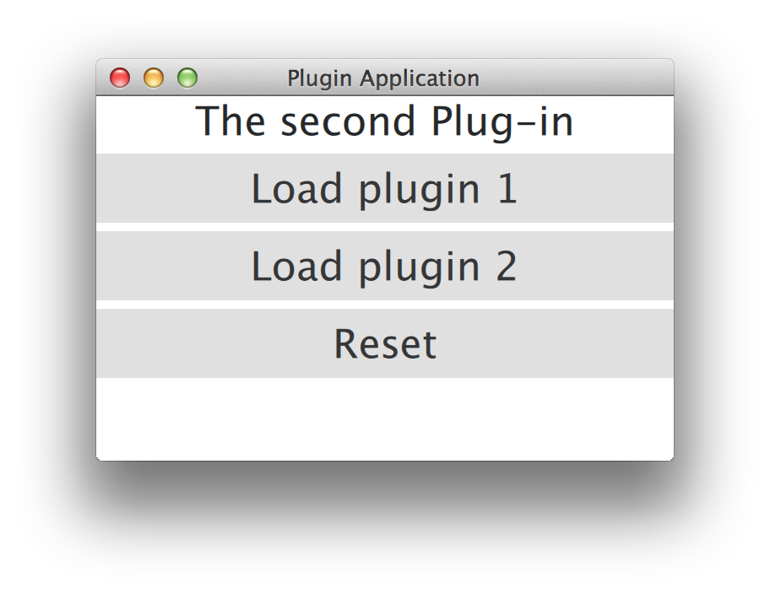
Lab – Custom Plugin
Define a custom interface
Implement one or more plugins, implementing the interface
Complete the skeleton program, loading the plugin
Further implementation details in readme.txt
lab-plugins

Slide 26
Qt Test

Slide 27
Contents
Creating a Unit Test
Running Tests
GUI Simulation
Asynchronous Tests
Benchmarking

Slide 28
Objectives
Learn…
…writing and executing unit tests with Qt Test
…testing signals and slots
…benchmarking code blocks

Slide 29
Qt Test Module Features
Lightweight | Consists of about 6000 lines of code and 60 exported symbols
Self-contained | Requires only a few symbols from the Qt Core library for non-GUI testing
Rapid testing | Needs no special test-runners; no special registration for tests
Data-driven testing | A test can be executed multiple times with different test data
Basic GUI testing | Offers functionality for mouse, touch, and keyboard simulation
IDE friendly | Outputs messages that can be interpreted by Visual Studio and KDevelop
Thread-safety | The error reporting is thread safe and atomic
Type-safety | Extensive use of templates prevent errors introduced by implicit type casting
Easily extendable | Custom types can easily be added to the test data and test output

Slide 30
Creating a Unit Test
A test project wizard provided in Qt Creator
Create two subprojects using SUBDIRS
The actual project
An adjacent test project
Example project .pro file
SUBDIRS = \
interestingProject.pro \
interestingProject_tst.pro
Write test cases, while you develop the code
Test-driven development
Do not mix test code and project code

Slide 31
Test Cases
class ExTestTest : public QObject
{
Q_OBJECT
public:
ExTestTest(); private:
// The two optional functions below may be private slots as well
void initTestCase(); // Called before any test has been executed
void cleanupTestCase(); // Called after all the test have been executed
// Test case functions must be private slots
// They are executed in the declaration order
private Q_SLOTS:
void testCase1();
void testCase2();
// Two optional test case functions executed differently
init(); // Called before each test case void
void cleanup(); // Called after each test case
};
ex-trivial-unit-test

Slide 32
Test Project
Macros QTEST_MAIN and QTEST_APPLESS_MAIN define the main() function
Instantiate the test class and execute all the test cases
All the test case functions are run on that same instance
Macros suggest that each test class is compiled and linked to one executable

Slide 33
Running Tests Command Line Options
Output format
txt
csv
xml
xunitxml
Verbosity
silent – failure and fatal errors only
v1- start of each test function
v2 – each QVERIFY/QCOMPARE/QTEST
Testing options
functions – list test functions
datatags – list data tags
eventdelay – default delay in mouse and keyboard simulation in ms
nocrashhandler – useful for debugging crahses
./test
./test testCase1
./test testCase1:testData1

Slide 34
Test Results
Test cases may be
Skipped, if a tested feature is not present in the current configuration
QSKIP(“This test requires feature X”)
or blacklisted, if test cases are skipped in some platform, OS, toolchain, distribution or architecture
android
ios
winrt
[testSomethingNotPresentOnMobilePlatforms]
PASS : MyDataTest::initTestCase()
PASS : MyDataTest::myTestCase
PASS : MyDataTest::cleanupTestCase()
Totals: 4 passed, 0 failed, 0 skipped, 0 blacklisted
********* Finished testing of MyDataTest *********

Slide 35
Notes
If an exception is thrown, rest of the test functions are not executed
May produce misleading results
There may be more test functions skipped than reported
You can combine more than just one test class together
Do not use QTEST_MAIN or QTEST_APPLESS_MAIN
There is no new instance for each invocation of a test function
As you may have used to have in other test frameworks
Executable returns (QTEST_MAIN/QTEST_APPLESS_MAIN) a fail count by default, which is useful for scripts

Slide 36
Test Macros
Several useful macros available to write test cases
Defined in QTest name space
VERIFY(condition)
QTRY_VERIFY(condition)
QTRY_VERIFY_WITH_TIMEOUT(condition, timeout)
VERIFY2(condition, message)
An additional message is recorded into the test log if the condition is not true
QTRY_VERIFY2_WITH_TIMEOUT(condition, message, timeout)
QCOMPARE(actual, expected)
Records the actual and expected values into the test log if they do not match
QTRY_COMPARE(actual, expected)
QFAIL(message)
Fails the test case, supposed to be used within the logic of a test function
QWARN(message)
Can be used to record a message to the test log

Slide 37
Enabling Verbose Output
QCOMPARE macro uses QTest::toString() functions to output verbose data of different argument types in case the comparison fails
Useful to add support for relevant custom types by adding specializations of overloads
namespace MyNamespace {
char *toString(const MyPoint &point)
{
// bring QTest::toString overloads into scope:
using QTest::toString;
// delegate char* handling to QTest::toString(QByteArray):
return toString("MyPoint(" +
QByteArray::number(point.x()) + ", " +
QByteArray::number(point.y()) + ')');
}
}

Slide 38
Data-Centric Test Case
Possible to define data sets (tables) for tests
Data defined in testCase_data() functions
#include <QtTest/QTest>
class MyDataTest : public QObject
{
Q_OBJECT
private slots:
void myTestCase_data();
void myTestCase();
}
ex-data-test

Slide 39
Providing Test Data
Add columns with arguments and expected results
Add rows of data
The argument of the newRow() function defines a tag, which can be used to include a row in the test
By default all rows will be included
void MyDataTest::myTestCase_data()
{
// test data table with two columns
QTest::addColumn<int>("integer_input");
QTest::addColumn<QString>("result");
// test data
QTest::newRow("1st row") << 1 << “yahoo”;
QTest::newRow("2nd row") << 2 << “hello”;
QTest::newRow("3rd") << 3 << “yeah”;
}

Slide 40
Feeding Test Data for Test Case
Test function is called multiple times (number of rows)
Test function produces a single pass/fail result
void MyDataTest::myTestCase()
{
QFETCH(int, integer_input);
QFETCH(QString, result);
QCOMPARE(myTestedFunction(integer_input),result);
}

Slide 41
QTest GUI Testing Support
QTest class can be used to:
Simulate key events
Simulate key presses: Up and Down
Simulate mouse events: Click and Move
Simulate mouse presses: Up and Down
Simulate sequences of touch events
Check the current test function or data to initialize or cleanup something
Convert values of various types into strings

Slide 42
Simulate Key/Mouse/Touch Events
void MyTest::init()
{
_tested = new QLineEdit("default");
}
void MyTest::testcase()
{
QString defaultValue("default");
QString input("abc");
QTest::keyClicks(_tested, input);
// mouseClick(), mouseDClick(), mouseMove(), touchEvent()
QString result(_tested->text());
QString expected(defaultValue + input);
QCOMPARE(result, expected);
}
ex-keyinput

Slide 43
Testing Asynchronous Functions
No mock objects exist in QTestLib
Order and quantity of calls of slots/functions need to be recorded
QSignalSpy
The challenge is not to fall out the test slot function before verifying signals emitted by the tested class
QTest::qWait()?
How long to wait?
QSignalSpy::wait()
Starts an event loop
Waits until a signal or timeout occurs

Slide 44
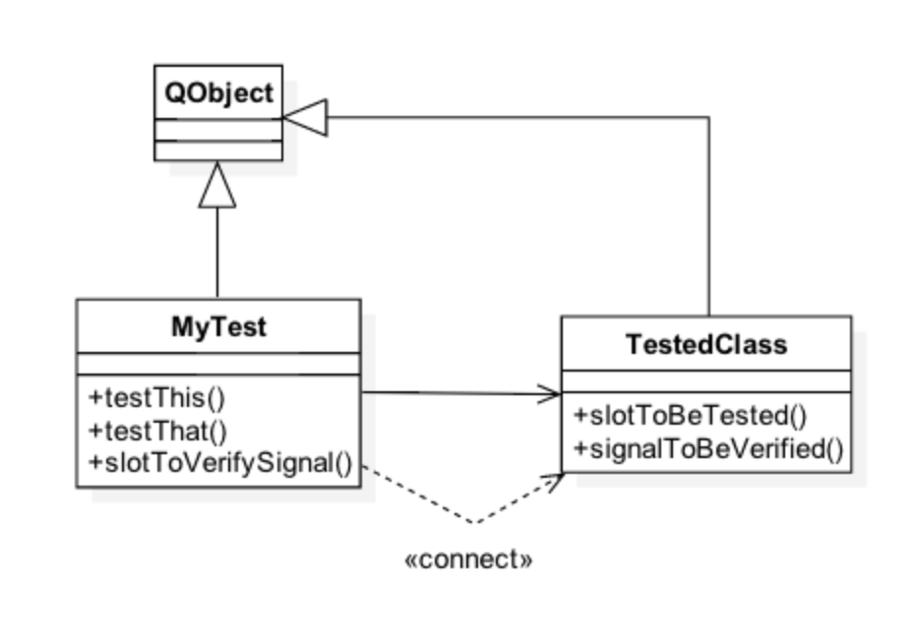
Asynchronous Signals
A signal can be emitted asynchronously after a tested slot is called
Test code needs to connect to that signal to receive it
The connected slot needs to verify the signal

Slide 45
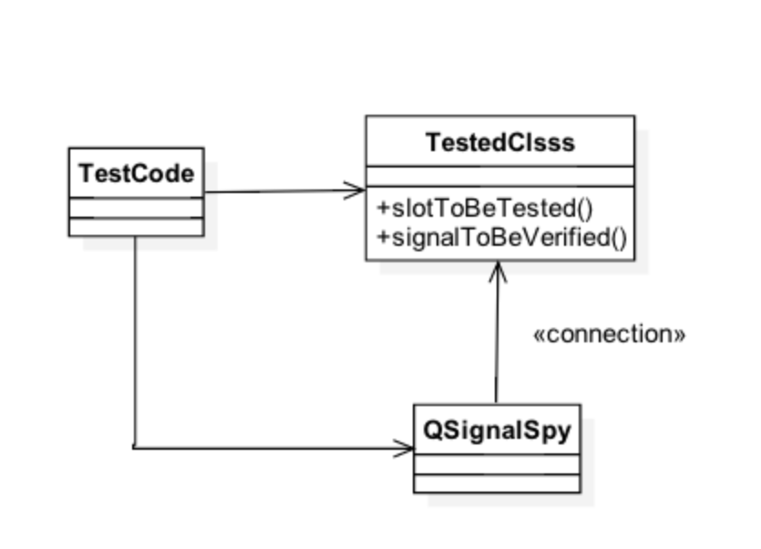
QSignalSpy
Can be used to record calls of a single signal
Records the values of the call

Slide 46
Example Test with QSignalSpy
void MyTest::testStart()
{
MyTimer timer;
QSignalSpy spy(&timer, &MyTimer::ownTimerTimeout);
QVERIFY(spy.isValid()); // valid signal
QVERIFY(spy.isEmpty()); // no calls, precondition
const unsigned long int Period = 2;
timer.ownStartTimer(Period);
QVERIFY(spy.wait(Period * 10));
const int result = spy.count();
QCOMPARE(result, 1); // one call expected
QList<QVariant> theCall = spy.takeFirst();
QVERIFY(theCall.isEmpty()); // no parameters
}
ex-signalspy

Slide 47
Recorded Calls
QSignalSpy is QList<QList<QVariant > >
All parameters of calls can be accessed and verified through QList
Values are stored as QVariants
QVariant provides converter functions
For example, QVariant::toInt()

Slide 48
QBENCHMARK Macro
Simple to use
Code block may be iterated
Affects to the test design and implementation
Several measurement back-ends possible
Wall time, CPU tick count, valgrind/callgrind, event count
Availability depends on the platform
Sometimes more straightforward to use QTime::elapsed() function

Slide 49
Benchmarking
QBENCHMARK { // or QBENCHMARK_ONCE
… code to be measured …
}
PASS : Container_perfTest::initTestCase()
PASS : Container_perfTest::testCase1()
RESULT : Container_perfTest::testCase1():
0.50 msecs per iteration (total: 64, iterations: 128)
PASS : Container_perfTest::testCase2()
RESULT : Container_perfTest::testCase2():
0.54 msecs per iteration (total: 70, iterations: 128)

Slide 50
Questions and Answers
What kind of tests can be written with Qt Test?
How tests are executed?
Name at least five macros, which can be used in writing tests. How do these macros work?
Explain differences between QTest::qWait() and QSignalSpy::wait(). Which one would you prefer in testing signals?
What should you take into account, when benchmarking code with QBENCHMARK?

Slide 51
Summary
Qt Test allows you to write unit tests for your classes
Qt Test provides a framework to implement and execute test functions
Several macros, such as QVERIFY, QCOMPARE, QSKIP, QFETCH, QBENCHMARK, are available to implement test cases
Test data can be provided in a table format
Data rows can be selected using the command line options
GUI events can be simulated in tests
Emitted signals and their parameters can be tested with QSignalSpy

Slide 52
Lab – Benchmarking Iterators
You are provided with a console program, using Java-style and STL-style iterators on an associative container
Create a test project with test functions, which benchmark the iterators
Java-style iterator
STL-style const iterator
Java-style mutable iterator
STLstyle non-const iterator
Q_FOREACH vs. range-based loop
You need to reset the iterator, if the benchmarked code is executed more than once
lab-benchmarking-iterators

Slide 53
Databases

Slide 54
Contents
Database Connection
Driver Plugins
SQL Queries
Database Item Models
Transactions

Slide 55
Objectives
Learn…
…how to manage database
…how to create and execute SQL queries
…mapping query results into item models

Slide 56
Qt Database Module
Qt contains cross-platform and database-independent SQL APIs
All database-specific code for accessing the database is hidden behind a special driver plug-in
In order to use the SQL support, add QT += sql to your .pro file

Slide 57
Database Connection
Provides an interface to a database using database-specific drivers
Any number of connections to one or more databases supported
QSqlDatabase::addDatabase(const QString &type, const QString &name) returns an object for the database connection
Type defines the driver to be used
Connection is identified by a name – using an existing connection name replaces the old one
Connection may only be used in the thread, where it was created
If no connection name is given, the default connection is used in SQL queries later on
QSqlDatabase::connection(const QString &name) returns a connection object, provided the connection has been previously added

Slide 58
Supported Connection Types
Due to license incompatibilities with the GPL, not all of the plugins are provided with open source versions of Qt
Driver type | Description
QDB2 QIBASE QMYSQL | IBM DB2, v7.1 and higher Borland Interbase Driver MySQL Driver
QOCI QODBC QPSQL | Oracle Call Interface Driver ODBC Driver PostgreSQL v7.3 and higher
QSQLITE QSQLITE2 QTDS | SQLite version 3 or above SQLite version 2 Obsolete, superseded by ODBC

Slide 59
Connecting to a Database
Connecting options can be provided with connection member functions
setDatabaseName() // May be a name, Oracle TNS name, MS Access .mdb file name
setHostName()
setUserName()
setConnectOptions()
setPassword()
Before any queries can be done, the database connection is opened using open()
Returns true if a connection could be established or false, if something went wrong

Slide 60
Connection Example
QSqlDatabase db = QSqlDatabase::addDatabase("QMYSQL");
db.setHostName("bigblue");
db.setDatabaseName("flightdb");
db.setUserName("acarlson");
db.setPassword("1uTbSbAs");
bool ok = db.open();
if (!ok)
qFatal() << "Error opening database: “ << db.lastError();

Slide 61
Connection Options
Database-specific options
Read only access
SSL connection required
Login timeout
Set with semicolon-separated key=value pairs
MySQL
db.setConnectOptions("CLIENT_SSL=1;CLIENT_IGNORE_SPACE=1");
ODBC
db.setConnectOptions("SQL_ATTR_ACCESS_MODE=SQL_MODE_READ_ONLY)

Slide 62
Error Handling
In case QSqlDatabase::open() fails, error messages and error codes can be obtained from the object returned by the method QSqlDatabase::lastError()
The error object contains, among others, the following methods:
driverText(),
databaseText(),
text()(a concatenation of the previous two functions),
type()(driver error number), and
number()(database error number)
Note that the text returned from databaseText() is most likely not localized

Slide 63
Database Tables, Records, and Features
Function tables() returns the list of tables and views
Function primaryIndex() returns a table’s primary index
To get meta-information about table’s fields, call record(const QString &tableName)
Returns QSqlRecord, containing table fields in undefined order
To check, whether the database driver supports some feature, use hasFeature() function
hasFeature(QSqlDriver::QuerySize)
Available drivers can be queried using drivers()

Slide 64
Driver Plug-ins
For non-supported database types custom driver plugins can be implemented
Not necessary to implement the plugin at all
QSqlDatabase::registerSqlDriver(“CUSTOMDRIVER”,
new QSqlDriverCreator<CustomDriver>);
Derive a class from QSqlDriver and implement the pure virtual functions
Provides concrete implementation of QSqlDatabase functions
Derive a class from QSqlResult and implement the pure virtual functions
Provides concrete implementation of QSqlQuery functions
Notice that the source code for existing drivers is provided in any Qt release – use those as examples!
Plenty of more information available in Qt Assistant, as well

Slide 65
Driver Plug-ins
class QSQLiteDriverPlugin : public QSqlDriverPlugin
{
Q_OBJECT Q_PLUGIN_METADATA(IID "org.qt-project.Qt.QSqlDriverFactoryInterface"
FILE "sqlite.json") public:
QSQLiteDriverPlugin(); QSqlDriver* create(const QString &) Q_DECL_OVERRIDE;
}; class QSQLiteDriver : public QSqlDriver
{
Q_OBJECT
public:
explicit QSQLiteDriver(QObject *parent = 0);
bool hasFeature(DriverFeature f) const Q_DECL_OVERRIDE;
bool open(const QString &db, const QString &user, const QString &password,
const QString &host, int port, const QString &connOpts);
// sqlite3_open_v2(file, sqlite3Struct, openMode)
QSqlResult *createResult()
QStringList tables(QSql::TableType) const Q_DECL_OVERRIDE; QSqlIndex primaryIndex(const QString &table) const Q_DECL_OVERRIDE;
qtbase/src/plugins/sqldrivers/sqlite

Slide 66
QSqlQuery
Wrapper to QSqlResult in the driver
Supports any query, supported by the driver
An optional argument can be given to the constructor, specifying which database to use
Run a query by calling exec()
size() reports how many rows were matched by a select query
I -1 if the number of rows can not be determined
numRowsAffected() tells how many rows were affected by a non-select query, say, an update query
QSqlQuery query;
if (!query.exec("SELECT name FROM author"))
// ...

Slide 67
SQL Queries
In case of a select statement, the result can be iterated over using QSqlQuery::next()
This method returns true as long as there are more records available
The value of the records is fetched using QSqlQuery::value(int), which returns a QVariant
For navigation you can use:
QSqlQuery::first(),
QSqlQuery::last(),
QSqlQuery::prev()
QSqlQuery::seek(int)
QSqlQuery::lastError() can be used to query for error messages
QSqlQuery query("SELECT country FROM artist");
while (query.next()) {
QString country = query.value(0).toString();
doSomething(country);
}
ex-query

Slide 68
Prepared Queries
May speed up inserting a large number of records
If the database does not support prepared queries Qt will translate the query into an ordinary query
Two kinds of prepared queries:
named bindings
positional bindings

Slide 69
Bindings
// Named bindings
QSqlQuery query;
query.prepare("INSERT INTO employee (id, name, salary) VALUES (:id, :name, :salary)");
query.bindValue(":id", 1001);
query.bindValue(":name", ”Employee 1");
query.bindValue(":salary", 10000000);
query.exec();
// Positional bindings
QSqlQuery query;
query.prepare("INSERT INTO employee (id, name, salary) VALUES (?, ?, ?)");
query.addBindValue(1002);
query.addBindValue(”Employee 2");
query.addBindValue(10000001);
query.exec();

Slide 70
Database Item Models
QSqlQueryModel wraps a QSqlQuery in a QAbstractItemModel
The result set of the query can be used with the model/view framework
The titles displayed in views are the column names from the database
Can be changed using QSqlQueryModel::setHeaderData()
QSqlTableModel wraps a single table in a model, and does therefore allow editing the items
Create an instance of QSqlTableModel, and call setTable() specifying the table to use
Optionally call setFilter() specifying a WHERE part of a SQL query
Optionally call setSort() specifying column number and sort direction
Call select() to execute the query
QSqlRelationalTableModel is QSqlTableModel subclass with a foreign key support
ex-query-model

Slide 71
QSqlTableModel vs. QAbstractItemModel
Possible to access the table programmatically using the methods of QAbstractItemModel
QSqlTableModel adds a few methods for convenience
record(), setRecord() and insertRecord() all work with instances of QSqlRecord
All refer to rows in the table rather than QModelIndexes
QSqlRecord is a simple container for records containing methods like
setValue(int index, QVariant value),
setValue(QString name, QVariant value), and similar
QVariant value(...) methods

Slide 72
QSqlTableModel
for (int row = 0; row < model->rowCount(); ++row) {
QSqlRecord record = model->record(row);
double price = record.value("price").toDouble();
price *= 1.1;
record.setValue("price", price);
model->setRecord(row, record);
}
model->submitAll();

Slide 73
Commit
Using setEditStrategy() it is possible to specify when changes made in the GUI should be committed to the database
Edit strategies
OnFieldChange – Data will be saved as soon as you start editing a new cell
OnRowChange – Data will be saved when you start editing a new record (changes can be discarded by calling revert())
OnManualSubmit – Data will only be saved when you call submitAll() (changes can be discarded with revertAll())
Be careful with OnFieldChange:
Performance can drop significantly compared to using the other editing strategies
If you modify a primary key, the record might slip through your fingers while you are trying to fill it

Slide 74
Editable Queries
Without modifications QSqlQueryModel is read only, while QSqlTableModel only works on a single table
To be able to edit the result of an arbitrary query, override
QAbstractItemModel::setData() to update the data yourself, and
QAbstractItemModel::flags() to specify that the table is editable
ex-editable-query

Slide 75
Transactions
You start a transaction using
QSqlDatabase::transaction(), and end it using
QSqlDatabase::commit() or
QSqlDatabase::rollback()
The above methods return true if the action succeeded
Transaction requires support from the database – check for this using
QSqlDriver::hasFeature(QSqlDriver::Transactions)

Slide 76
Questions and Answers
What is the role of QSqlDatabase?
Can you share database connection between threads? Justify.
How can you check, whether a required feature can be used with an existing database driver?
What kind of SQL queries are supported by QSqlQuery?
What and named and positional value bindings? Is it beneficial to use them?
What kind of item models can be used with databases?
What should be taken into account performance wise when using QSqlTableModel?
Does Qt support transactions?

Slide 77
Summary
Qt has support to make SQL queries to the database
Intuitive Qt-style APIs provided for composing the queries
Queries are made using an open database connection
Several connections may be opened to the same database
Connections are value types, which cannot be shared between threads
Qt database system is based on the model/view framework with three layers
Database technology -based drivers – connection and query objects are wrappers to the driver object
Model classes – mapping query result or a single table
View classes – Widgets or QML types

Slide 78
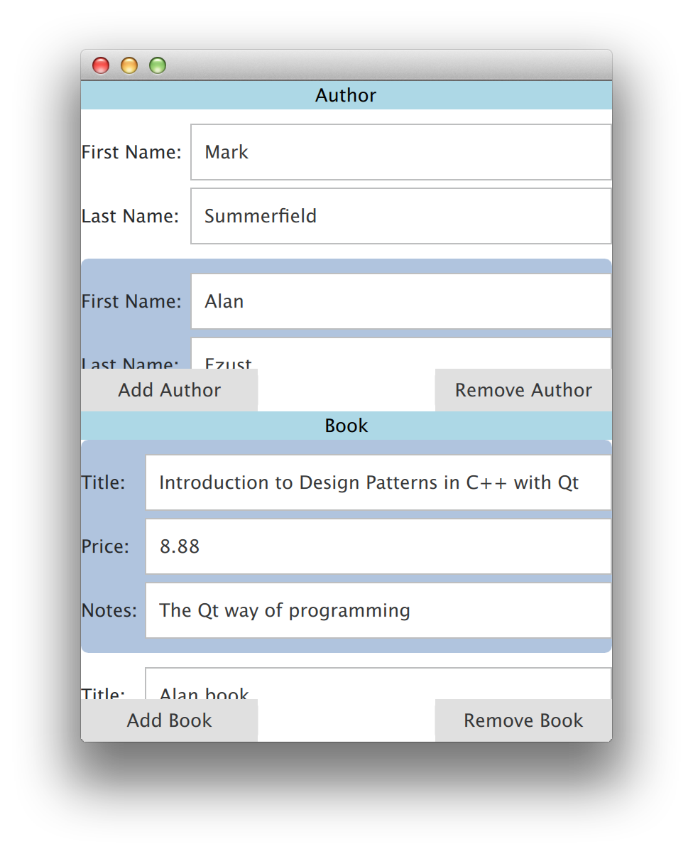
Lab – Bookstore
Author table in upper view
Book table in lower view
Only books from current author shown
Follow these steps (more details in readme.txt)
Setup the author table (QSqlTableModel)
Setup the proxy tables to map columns
Setup book table with QSqlQueryModel
Provide edit support for both tables
Optional
Support add/delete rows
lab-bookstore

Slide 79
Multimedia

Slide 80
Contents
Qt Multimedia Features
Architecture
Audio and Video Playback
Audio and Video Recording
Custom Video Surface
FM Radio

Slide 81
Objectives
Learn…
…what services Qt Multimedia module provides
…audio and video playback and recording
…accessing video pixel data

Slide 82
Qt Multimedia Features
Media file playback
QMediaPlayer
QMediaPlaylist, QMediaContent
QVideoWidet
Audio device access
QAudioDeviceInfo
QAudioInput, QAudioOutput
QAudioFormat
QAudioBuffer – audio media stored in memory for processing
Low latency sound effects
QSound – plays .wav files
QSoundEffect
Camera and view finder
QCamera
QAbstractVideoSurface
QAbstractVideoFilter – for QML
QVideoFrame
Audio buffer and video frame monitoring
QAudioProbe
QVideoProbe
FM radio
QRadioTuner
QRadioData
3D positional audio – Qt Audio Engine

Slide 83
Multimedia Architecture
High-level multimedia classes derive from QMediaObject
QMediaPlayer, QAudioRecorder, QCamera, QRadioTuner
Media object
Provides access to meta-data: title, language, copyright, publisher
Provides internally a media service object, which actually implements the multimedia service
Allows binding helper objects, implementing QMediaBindableInterface
QMediaService implements one or more media control interfaces
E.g., QAudioRecorderComtrol, QCameraZoomControl, QRadioDataControl
Helper objects extend media object functionality
QMediaPlaylist, QRadioData, QVideoWidget

Slide 84
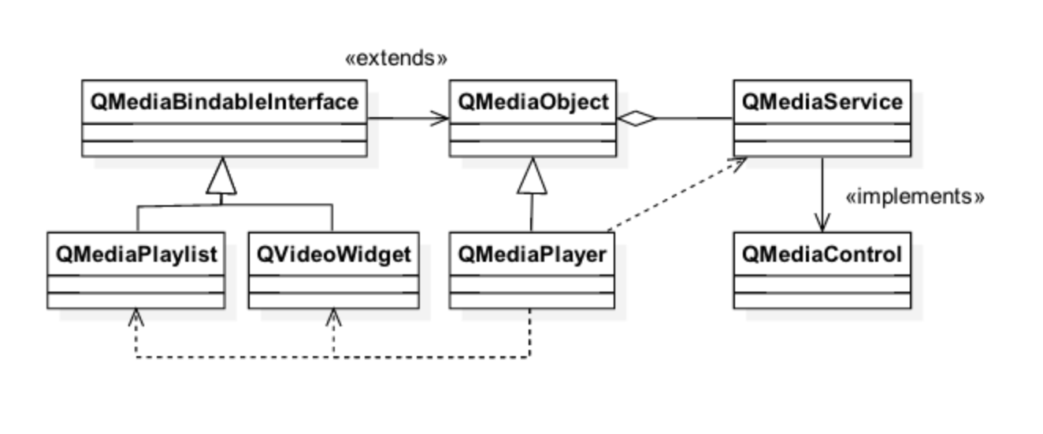
Audio and Video Playback
QMediaPlayer is a media object using internally a certain media service
Extended with QMediaPlaylist and QVideoWidget helper classes

Slide 85
Audio and Video Playback
m_player = new QMediaPlayer;
m_playlist = new QMediaPlaylist(m_player);
m_playlist->addMedia(QUrl("video.mp4"));
m_widget = new QVideoWidget();
m_player->setVideoOutput(m_widget);
m_playlist->setCurrentIndex(1);
m_player->play();
FileDialog { id: filedialog
title: qsTr("Please choose a media file")
folder: shortcuts.home
onAccepted: mediaplayer.source = filedialog.fileUrls[0];
}
VideoOutput { id: videooutputvideo
anchors { top: parent.top; bottom: toolbar.top }
width: parent.width source: mediaplayer
} MediaPlayer { id: mediaplayer }
ex-avplayer-widgets and ex-avplayer-qml

Slide 86
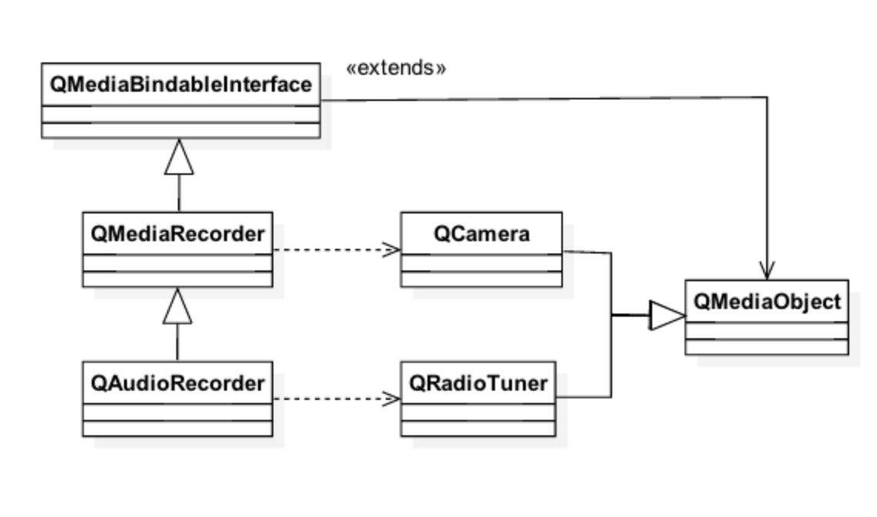
Audio and Video Recording

Slide 87
Audio and Video Recording
QAudioRecorder allows recording and compressing audio data
QMediaRecorder allows recording video
Set the source in the constructor (a camera or a radio tuner)
Set audio settings as above
Start recording
audioRecorder = new QAudioRecorder;
QAudioEncoderSettings audioSettings;
audioSettings.setCodec("audio/amr"); audioSettings.setQuality(QMultimedia::HighQuality);
audioRecorder->setEncodingSettings(audioSettings);
audioRecorder->setOutputLocation(QUrl::fromLocalFile("test.amr"));
audioRecorder->record();

Slide 88
Other Audio Classes
QSoundEffect
Low latency WAV format sound effects
Volume, mute, and number of loops may be controlled
QAudioProbe
Monitor played or recorded audio data
Any media object may be used as a source
QAudioOutput and QAudioInput
Raw audio data output and input
Available HW determines what audio input and outputs are available
Qt Audio Engine
QML module for providing 3D positional audio playback and content management
Wave files are organized into discrete Sound instances, which are grouped and controlled using categories

Slide 89
Accessing Low Level Video Frames
Useful when accessing barcodes or applying fancy effects to the frames
Set the video output of the media player to your custom surface
class MyVideoSurface : public QAbstractVideoSurface
{
QList<QVideoFrame::PixelFormat> supportedPixelFormats(
QAbstractVideoBuffer::HandleType handleType =
QAbstractVideoBuffer::NoHandle) const {
Q_UNUSED(handleType);
// Return the formats you will support
return QList<QVideoFrame::PixelFormat>() << QVideoFrame::Format_RGB565;
}
bool present(const QVideoFrame &frame)
{
Q_UNUSED(frame);
// Handle the frame and do your processing return true;
}
ex-custom-video-widget

Slide 90
FM Radio
Radio tuner + access to RDS
QRadioTuner
Media object
Frequency control
Stereo mode control
Provides access to QRadioData
QRadioData
Station name
Station id
Radio text
radio = new QRadioTuner;
connect(radio, SIGNAL(frequencyChanged(int)), this,
SLOT(freqChanged(int)));
if (radio->isBandSupported(QRadioTuner::FM)) {
radio->setBand(QRadioTuner::FM);
radio->setFrequency(yourRadioStationFrequency);
radio->setVolume(100);
radio->start();
}

Slide 91
Questions and Answers
What are media objects, media services, and media controls and how are they related to each other?
In which ways is it possible to play back audio using Qt multimedia?
Which media codecs are supported by Qt?
How video frames can be manipulated?
How would you provide data to computer vision libraries, such as OpenCV?

Slide 92
Summary
Qt Multimedia provides a rich set of multimedia features
Audio and video playback and recording
Low-latency sound effects
Manipulation of raw audio data and video frames
FM radio
3D audio
Features are used with media objects
Media objects use media services, which actually implement the requested services – possibly using the underlying platform libraries
Media objects may be extended with helper objects, like media player can be extended with a play list and video widget
Qt allows monitoring and changes audio buffers and video frames

Slide 93
Speech

Slide 94
Contents
Qt Speech
Text to Speech

Slide 95
Objectives
Learn…
…Qt APIs to text to speech engines

Slide 96
Qt Speech
Currently supports Text to Speech (TTS) only
QT += texttospeech
Uses platform APIs to access text to speech engines
In Linux, Speech Dispatcher library needed
Speech recognition module under development

Slide 97
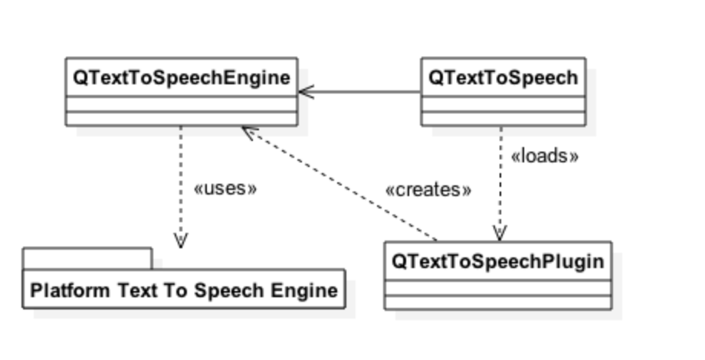
Text to Speech
All functionality implemented in the backend engine
QTextToSpeech is a wrapper to the engine
Query the engines with availableEngines()
Select the engine in the constructor
Query and set the
language: QVector<Qlocale> availableLocales()
voice: QVector<QVoice> availableVoices()

Slide 98
Voice Control
QVoice controls the voice
Age (Child, Teenager, Adult, Senior, Other)
Gender (Male, Female, Unknown)
Name
QTextToSpeech allows controlling
the rate and pitch in the range [-1.0, 1.0]
the volume in the range range [0, 100]
Text is synthesized asynchronously using function say(const QString &)

Slide 99
Text To Speech
QStringList engines = QTextToSpeech::availableLocales();
// Let the user to select the engine
m_speech = new QTextToSpeech(engine, this);
QVector<QLocale> locales = m_speech.availableLocales();
// Let the user select the language
m_speech.setLocale(locale);
m_speech.setRate(rate); m_speech.setPitch(pitch);
QVector<QVoice> voices = m_speech.availableVoices();
// Let the user select the voice
m_speech.setVoice(voice);
m_speech.say(“Hello World”);

Slide 100
Summary
Qt Speech module supports access to speech synthesizer engines
QTextToSpeech is a simple wrapper, which loads the engine and calls its members to synthetize speech
QTextToSpeech allows a user to choose a language and voice
Volume, rate, and pitch can be controlled as well
Voices are provided by the platform
Voice parameters include gender and age
Voices are identified by a string name

Slide 101
XML and JSON

Slide 102
Contents
XML APIs
XML Parsing with Stream Reader
Stream Writer
XQuery and XPath
XML Schema
JSON support

Slide 103
Objectives
Learn…
…XML parsing options
…XML parsing with XML stream reader
…XQuery in Qt
…JSON parsing

Slide 104
XML APIs
Qt provides three different means of accessing XML data:
SAX (simple API for XML, version 2)
Provides a sequential view on the data using call backs
Stream Reader/Writer
Also a sequential view, but control is in the application
Makes it easier to write recursive descent parsers
DOM (document object model, level 1 and 2), which provides a tree view on the data
SAX and DOM APIs are deprecated and not covered here

Slide 105
XML Parsing with Stream Reader
QXmlStreamReader provides fast and efficient way to parse XML
Well-formed XML 1.0 parser
Small memory usage
XML data is parsed by pulling tokens using TokenType readNexr()
Only current token kept in memory
String data reported with QStringRef
Incremental parsing
Data read in chunks
PrematureEndOdDocumentError reports the document was not fully parsed
Possible to resume once data is available

Slide 106
QXmlStreamReader
Data may be read from any QIODevice, string, byte array or char pointer
QXmlReader reader(tcpSocket);
Function addData() adds more data for the reader
Data is read in the loop using readNext() or readNextStartElement()
while (!reader.atEnd()) {
while (reader.readNextStartElement())
Irrelevant elements may be skipped with skipCurrrentElement()
Fetch element data
name() – element name
text(), or readElementText() – returns everything till the matching end token as text
attributes.value(“attributeName”)

Slide 107
QXmlStreamReader
Error handling
If readNext() reports an error, it returns EndDocument, which means atEnd() returns true
if (reader.hasError)
Error error = reader.error();
You can also signal an error yourself using raiseError(QString msg)
if (reader.readNextStartElement()) {
if (reader.name() != ”bookmarks” || xml.attributes().value("version") != "4.2”)
xml.raiseError(QObject::tr("The file is not a bookmarks version 4.2 file."));
else
// Continue handling
}

Slide 108
QXmlStreamWriter
Allows you to write XML in a streaming fashion, using high level functions
Data are written using methods like writeStartDocument(), writeStartElement(), writeEndElement(), writeAttribute(), writeCharacters()
Specify the device to write to using setDevice(QIODevice*)
To get human readable XML generated (e.g. new lines in place), call setAutoFormatting(true)
ex-xml-stream-writer

Slide 109
XQuery and XPath
An improved way of working with XML where your level of abstraction is higher than regular XML
Allows you both to parse complex XML, and to generate XML based on another XML file
You can:
read data from XML
filter and sort the data, make search and select tasks
write the result to a new XML document
create a completely new XML document
The XQuery-related classes can be found in the Qt XmlPatterns module
Also used in XMLListModel in QML
Queries can be run from within your C++ code or using a separate command line utility application (called xmlpatterns)

Slide 110
XQuery and XPath
Write XQuery statements in your code or in a separate text file (e.g. myqueries.xq)
Starting from the document (root) node of cars.xml
Pick each <car> element anywhere in the document where the <engine> child element’s value is ”V8”
<selectedcars>
doc(“cars.xml")/car[engine = “V8"]
</selectedcars>
<?xml version="1.0"?>
<cars>
<car>
<make>Trabant</make>
<model>Convertible</model>
<engine>V8</engine>
</car>

Slide 111
XQuery in Qt
QXmlQuery executes queries in the XQuery language
A query is added with QXmlQuery::setQuery() and evaluated with the QXmlQuery::evaluateTo() methods
Queries can be evaluated to QStringList, QXmlResultItems or QAbstractXmlReceiver

Slide 112
Evaluating to QStringList
Evaluating to QStringList is possible only if the query evaluates to a sequence of string values
Example - read the text element from the paragraphs of index.html and puts the result into a QStringList
QXmlQuery query;
query.setQuery("doc(’index.html’)/html/body/p/string()");
QStringList result;
query.evaluateTo(&result);

Slide 113
Evaluating to QXmlResultItems
QXmlResultItems is a sequence of QXmlItems
A QXmlItem represents either a node or an atomic value
A null item means it is invalid
The query below evaluates to a node, an integer and a string
QXmlQuery query;
query.setQuery("<myNode />, 1, ’a string’");
QXmlResultItems result;
query.evaluateTo(&result);
QXmlItem item(result.next());
while (!item.isNull()) {
// use item
item = result.next();
}

Slide 114
Evaluating to QAbstractXmlReceiver
QAbstractXmlReceiver is an abstract class, acting as a callback interface for query evaluation
Can be used to transform the output of a QXmlQuery
Its methods are called when an attribute, start/end element, comment, atomic value is found
QXmlSerializer and QXmlFormatter are implementations of this interfaces and can be used to save the query result into an XML file

Slide 115
Evaluating to QXmlSerializer
QXmlSerializer: translates an XQuery sequence to XML and writes the result into a QIODevice
Example, selecting the first paragraph from the html body:
The output is not formatted, for example:
<p><b>First</b> paragraph</p>
QXmlQuery query;
query.setQuery("doc(’index.html’)/html/body/p[1]");
QXmlSerializer serializer(query, myOutputDevice);
query.evaluateTo(&serializer);

Slide 116
Evaluating to QXmlFormatter
QXmlFormatter can be used to format the result of a query
Example output with QXmlFormatter:
<p>
<b>First</b> paragraph
</p>
QXmlQuery query;
query.setQuery("doc(’index.html’)/html/body/p[1]");
QXmlFormatter formatter(query, myOutputDevice);
formatter.setIndentationDepth(4);
query.evaluateTo(&formatter);

Slide 117
QAbstractXmlNodeModel
Modeling non-XML data to look like XML for QXmlQuery
Rather complex to sub-class, QSimpleXmlNodeModel often used
Read data from the file using a node model
The model will create the XML nodes
Create an XML query to read queries from the nodes
Bind the root query variable and the root node
Evaluate the query

Slide 118
QAbstractXmlNodeModel
QFile queryFile(argv[1]);
QFile chemistryData(argv[2]);
QString moleculeName = argv[3]; QXmlQuery query;
query.setQuery(&queryFile, QUrl::fromLocalFile(queryFile.fileName())); ChemistryNodeModel myNodeModel(query.namePool(), chemistryData);
QXmlNodeModelIndex startNode = myNodeModel.nodeFor(moleculeName);
query.bindVariable("queryRoot", startNode); QFile out;
out.open(stdout, QIODevice::WriteOnly); QXmlSerializer serializer(query, &out);
query.evaluateTo(&serializer);
ex-filetree

Slide 119
XML Schema
XML Schema is a W3C standard
http://www.w3.org/XML/Schema
Qt supports XML Schema 1.0
Schemas specify the structure and contents of XML documents
QXmlSchema represents a schema
Documents are validated against schemas
QXmlSchemaValidator is used to validate documents

Slide 120
Loading a Schema
Schemas are represented by Uniform Resource Identifiers (URIs)
Can use the URI to locate the schema
QXmlSchema::load(QUrl(...))
Uses the URI as a URL
The schema will be fetched over the network
Can be loaded from a QIODevice or QByteArray:
QXmlSchema::load(device, QUrl(...))
QXmlSchema::load(bytes, QUrl(...))
The URI passed as a QUrl is optional
Optional URIs are used to resolve relative URIs in the schema

Slide 121
Loading a Schema from a URL
Loading a schema from a remote location:
You must verify that the schema is valid
QUrl url("http://www.schema-example.org/myschema.xsd");
QXmlSchema schema;
if (schema.load(url))
qDebug() << "schema is valid";
else
qDebug() << "schema is invalid";

Slide 122
Loading a Schema from a File
Sometimes better to cache schemas locally
Passing a valid URI helps to resolve references in the schema
QFile file("test.xml");
file.open(QIODevice::ReadOnly); QXmlSchemaValidator validator(schema);
if (validator.validate(&file, QUrl::fromLocalFile(file.fileName())))
qDebug() << "instance document is valid";
else
qDebug() << "instance document is invalid";

Slide 123
Validating a Document
Documents are also represented using URIs:
Can use the URI to locate the document
QXmlSchemaValidator::validate(QUrl(...))
Uses the URI as a URL.
The document will be fetched over the network.
Can be read and validated from a QIODevice or QByteArray:
QXmlSchemaValidator::validate(device, QUrl(...))
QXmlSchemaValidator::validate(bytes, QUrl(...))
The URI passed as a QUrl is optional
ex-xml-schema

Slide 124
JSON
Format to encode object data in JS
Six basic types
Bool, double, string, array [], object {}, null
{
“key1”: “value1”,
“key2”: “value2”,
“objectKey”: {
“key4”: “value4”,
“key5”: “value5”
},
etc.

Slide 125
JSON Parsing with QJsonDocument
Provides APIs to parse, modify, and save JSON data
Speed optimized binary format that is directly memory map-able and very fast to access
QJsonDocument::fromJson() / toJson()
Parses UTF-8 encoded JSON document to the binary format and back
The document contains an array or an object
QJsonArray/QJsonObject classes provide API to parse and modify the content
An object contains key-value pairs, where a value can be an array, object or any of the basic types
The easiest way to parse arrays or objects is to use iterators
QJsonObject jsonObject(document.object());
if (jsonObject.contains(“key1")) {
QJsonValue value(jsonObject.take(“key1"));

Slide 126
void parseObject(const QJsonObject &object, QXmlStreamWriter &writer)
{
QStringList keys = object.keys();
for (const QString &key : keys) {
writer.writeStartElement(key);
parseValue(object.value(key), writer);
writer.writeEndElement();
}
}
void parseValue(const QJsonValue &value, QXmlStreamWriter &writer)
{
if (value.isArray())
parseArray(value.toArray(), writer);
else if (value.isObject())
parseObject(value.toObject(), writer);
else if (value.isBool()) {
if (value.toBool())
writer.writeCharacters("true");
else
writer.writeCharacters("false");
}
// and so on for double and undefined types
}
ex-json-to-xml

Slide 127
Performance
XML stream reader and writer provide typically always the best performance
However, the performance is benchmarked to be slower compared to xmllib, for example (10-50%)
DOM tree provides rather good performance, because all data access may be done in memory
However, slows done with large (>10 MB) XML documents
SAX performance is the worst and the idea is to make porting easier
Now you should port directly using stream reader and writer
JSON handling is better optimized than DOM tree as an internal binary data format is used

Slide 128
Questions and Answers
What alternatives are there to parse XML in Qt?
When would you benefit using XQuery and XPath compared to XML stream reader and writer?
What makes XML stream reader memory efficient?
How JSON processing is optimized in Qt?

Slide 129
Summary
Qt provides four ways for parsing XML
XML stream reader and writer
SAX parser
XML parsing using the DOM tree
Parsing with XQuery and QPath
SAX parser and DOM tree are deprecated and they should be used in legacy code only
Performance wise XML stream reader / writer provides typically the best performance
Typical use case is recursive XML parsing
XQuery provides more convenient way for parsing than XML stream reader, if only certain data is relevant from the XML document
Fetch all elements, where data values satisfy a required condition

Slide 130
Lab – Reading and Writing Xml Keys
KeyEngine class allows storing key-value pairs
Your task to write XML read/write backends
XML Format shall be:
<?xml version="1.0" encoding="UTF-8"?>
<keys version="1.0”>
<item key="Key-0">Value-0</item>
<item key="Key-1">Value-1</item>
…
<item key="Key-9">Value-9</item>
</keys>
lab-xmlkeys

Slide 131
SCXML

Slide 132
Contents
SCXML
QScxmlStateMachine
Data Models
Invoking Services

Slide 133
Objectives
Learn…
…Qt SCXML support
…essential classes and QML types to access state machines

Slide 134
SCXML
Allows creating state machines statically (during build time) or dynamically (run-time) from SCXML files
Both C++ and QML types provided
Allows clear separation of an application UI and application logic
Based on the meta-object system
State transition can be triggered by a signal
Property values may be set and methods may be invoked in states

Slide 135
SCXML Specification Briefly
http://www.w3.org/TR/scxml/
States
Can be nested, can be parallel
May be initial, final or history state
May invoke external services, Qt supports only other another SCXML state machine
May contain transitions
<state id=”state1" initial=”state11">
<state id=”state11”>
Transitions
Triggered by an event
May have a condition
<transition event=”someEvent" cond="In(’someParallelState')" target=”stateX"/>

Slide 136
SCXML Specification Briefly
States may have executable content inside <onentry> and <onexit> elements
Raise events - <raise event=”anEvent"/>
Send events to external systems - <send event=”anEvent" id=”evId" delay=“3s"/>
Event parameter(s) are QVariant(Map)
In case of error events, _event.errorMessage contains a more detailed description of an error
Log messages - <log label="'result'" expr=”1 + 3" />
Execute scripts- <script src=“scripts.js”> or <script>someVar = cppModelFunction()…</script>
Assign values to a data model - <assign location=”dataModel_var" expr=“1 + 3” />
States and state machines may have 0 or more data models
ECMAScript model - <datamodel><data id=”score" expr="0"/></datamodel>
C++ data model - datamodel="cplusplus:DataModel:datamodel.h”
Null data model

Slide 137
SCXML Example
<?xml version="1.0" ?>
<scxml xmlns="http://www.w3.org/2005/07/scxml" version="1.0"
initial="wrapper" datamodel="ecmascript" name="CalculatorStateMachine">
<datamodel>
<data id="long_expr" />
<data id="short_expr" />
<data id="res" />
</datamodel>
<state id="wrapper" initial="on">
<state id="on" initial="ready">
<onentry>
<send event="DISPLAY.UPDATE" />
</onentry>
<state id="ready" initial="begin">
<state id="begin">
<transition event="OPER.MINUS" target="negated1" />
<onentry>
<assign location="long_expr" expr="''" />
<assign location="short_expr" expr="0" />
<send event="DISPLAY.UPDATE" />

Slide 138
Creating a State Machine
Dynamic creation
auto *stateMachine = QScxmlStateMachine::fromFile(”voiceController.scxml");
Alternatively, QScxmlCompiler can be used
QScxmlCompiler compiler(xmlStreamReader); // Use stream reader to read the file
QScxmlStateMachine *stateMac = compiler.compile();
In QML use StateMachineLoader
StateMachineLoader { // State machine available as property stateMachine
source: “voiceController.scxml”
}
Static creation
Use qscxmlc tool to compile the SCXML file
STATECHARTS = voiceController.scxm
VoiceController voiceController; // Type may be registered as a QML type

Slide 139
QScxmlStateMachine
Start and stop the state machine
Exposes all state machine states as Boolean properties
Access states
QStringList stateNames(bool compress = true) const
QStringList activeStateNames(bool compress = true) const
Observer state changes and events
QMetaObject::Connection connectToState(const QString &stateName,
const QObject *receiver, PointerToMemberFunctio method)
QMetaObject::Connection connectToEvent(const QString &eventSpec,
const QObject *receiver, PointerToMemberFunctio method)

Slide 140
QScxmlStateMachine
Submit events
submitEvent(const QScxmlEvent *event)
submitEvent(const QString &eventName, const QVariant &data)
cancelDelayedEvent(const QString &sendId)
Set the data model and initial values
Can be set only once – setDataModel(QScxmlDataModel *model)
void setInitialValues(const QVariantMap &initialValues)

Slide 141
QScxmlStateMachine Example
m_machine->start();
// Observer slot may have a Boolean arg to see, if the state is entered or exited m_machine->connectToState(state, observer, &Observer::notify);
// updateScore has two parameters
// <send event="updateScore">
// <param name="highScore" expr="highScore"/>
// <param name="score" expr="score"/>
m_machine->connectToEvent("updateScore", [this] (const QScxmlEvent &event) {
const QVariant data = event.data();
const QString highScore = data.toMap().value("highScore").toString();
}
m_machine->submitEvent("randomEvent");

Slide 142
State Machine in QML
property StateMachine stateMachine: scxmlLoader.stateMachine
StateMachineLoader { id: scxmlLoader }
EventConnection {
stateMachine: root.stateMachine
events: ["playbackStarted", "playbackStopped"]
onOccurred: {
var media = event.data.media
theLog.text = "\nplaybackStarted with data: " + JSON.stringify(event.data)
}
} function tap(idx) {
var media = theModel.get(idx).media
var data = { "media": media }
stateMachine.submitEvent("tap", data)
}

Slide 143
Data Models
Base class QScxmlDataModel
Model property access methods
bool hasScxmlProperty(const QString &name) const
bool setScxmlProperty(const QString &name, const QVariant &value,
const QString &context)
QVariant scxmlProperty(const QString &name)
Pure virtual functions for evaluating executable content
virtual QVariant evaluateToVariant(QScxmlExecutableContent::EvaluatorId id,
bool *ok) = 0
Three subclasses
QScxmlCppDataModel
QScxmlNullDataModel
QScxmlEcmaScriptDataModel

Slide 144
QScxmlCppDataModel
Macro Q_SCXML_DATAMODEL results qscxmlc to generate required evaluation functions
Makes members accessible in SCXML
#include "qscxmlcppdatamodel.h"
class TheDataModel: public QScxmlCppDataModel
{
Q_OBJECT
Q_SCXML_DATAMODEL // Results qscxmlc to generate evaluate functions
private: // Note private members
bool isValidMedia() const; // evaluateToBool
QVariantMap eventData() const; // evaluateToVariant QString media; // evaluateToVariant
};

Slide 145
QScxmlCppDataModel
Allows adding C++ statements in <script> elements
Allows using C++ expressions in cond and expr attributes
<scxml
xmlns=http://www.w3.org/2005/07/scxml
datamodel="cplusplus:TheDataModel:thedatamodel.h"
>
<state id="stopped">
<transition event="tap" cond="isValidMedia()" target="playing"/>
</state> <state id="playing">
<onentry>
<script> media = eventData().value(
QStringLiteral(&quot;media&quot;)).toString();
</script>

Slide 146
Invoking Services
Only other SCXML state machines can be invoked as services
Allows having a state machine inside a state machine
Accessible with
QVector<QScxmlInvokableService *> QScxmlStateMachine::invokedServices() const or
InvokedServices in QML
Same features as the outer state machine

Slide 147
Summary
Qt SCXML allows creating state machines from XCXML files
QScxmlStateMachine provides functions
to access states
to observe state changes and events
to send events
to access invoked services to access data models
QScxmlDataModel sub-classes allow accessing data model locations and expressions

Slide 148
Inter-Process Communication

Slide 149
Contents
Running Processes
Inter-Process Communication
Shared Memory
QtDBus – Qt Bindings to D-Bus
File Watcher

Slide 150
Objectives
Learn…
…how to launch and terminate processes
…how to communicate between processes with standard input and output
…IPC options in Qt
…how to use shared memory
…how to use Desktop-Bus
…how to observe changes in the file system

Slide 151
Processes
QProcess allows launching external programs and communicating with them
Both synchronously and asynchronously
After the process has been created, it enters the Starting state
After the process is started, it enters Running state and emits started() signal
Process may be started several times (platform dependent behavior)
QString program = "./helloworld";
QStringList arguments;
arguments << "-style" << "motif";
QProcess *aProcess = new QProcess(parentObject);
aProcess->setProgram(program);
aProcess->setArguments(arguments);
aProcess->start();

Slide 152
Asynchronous Process Invocation
QProcess::start() starts the process asynchronously
Function returns possibly before the child process is running
Signals started() or errorOccurred() tell whether the process was started successfully
start() may be called several times – no effect on the running process
Static QProcess::startDetached() starts a child process and detaches it from the current one
This method will not wait for termination, and the child process will not be terminated when the current process terminates (“fire and forget”)

Slide 153
Synchronous Process Invocation
Wait until the child process has started (or finished)
waitForStarted() returns when the started() signal has been emitted
waitForFinished() returns when the finished() signal has been emitted
execute()Is another way to start a process synchronously
Starts a process and waits for its termination
Does not allow processing the child input or sending output to the child
Calling these methods in the main (GUI) thread will freeze your user interface
QStringList arguments;
arguments << "Argument1" << "Argument2";
QProcess::execute("do_it_now", arguments);
// won’t get here until do_it_now terminates

Slide 154
Inter-Process Communication
As straightforward as accessing the files
Thanks to QIODevice
Write process’s standard input using write() and read from the standard output using read(), readLine(), readAll(), getChar()
QProcess gzip;
gzip.start("gzip", QStringList() << "-c");
if (!gzip.waitForStarted())
return false;
gzip.write(“Hello World!");
gzip.closeWriteChannel();
if (!gzip.waitForFinished())
return false;
QByteArray result = gzip.readAll();
ex-simple-ipc

Slide 155
Inter-Process Communication Options
QSharedMemory
Reference count object, can be opened by any process
Simple memcpy() used to read/write to the process
Servers (QCoreApplication instances)
QLocalSocket used (local loop TCP socket)
DBus
Extends signal/slot mechanism between processes
DBus protocol must be supported by the platform
QCop (Qt Communication protocol)
Available only in Qt for embedded Linux prior Qt 5
Platform-dependent functionality
Message queues, pipes

Slide 156
Shared Memory
QSharedMemory class
Works between processes and threads
Processes recognize the piece of shared memory using a key (QString)
Process attach and detach to shared memory using the key
Do not de-allocate shared memory buffer
Reference count – will be freed, when all QSharedMemory objects referencing it have been deleted
Mutual exclusion is taken care by the developer
Use lock() and unlock()

Slide 157
Shared Memory Example
QSharedMemory mem(QString(“thekey”), 0);
// Create a new/old shared memory
mem.create(SIZE);
mem.lock(); // uses QSystemSemaphore internally
char *to = (char*)mem.data();
const char *from = buffer.data();
memcpy(to, from, qMin(mem.size(), SIZE));
mem.unlock();
ex-ipc

Slide 158
D-Bus
D-Bus itself is a server
Message (remote procedure call) –based communication between processes
Applications (service providers) send messages to D-Bus, which routes the messages to one or more receiver
Abstract
D-Bus does not define, which mechanism (e.g. sockets) actually transfers the messages
Two kinds of daemons
System-wide singleton (for system messages, such as signal strength, battery level)
User session –specific (between applications)

Slide 159
D-Bus Concepts
Object paths
A mechanism to locate, which native object (GObject, Java Object, Qt QObject) provides a service
E.g. company/services/serviceX
Each object may have method and signal members
Methods are (remote procedures) operations which can be invoked on an object with optional input and (possibly several) output values
Signals are broadcast from an object to all its observers (may contain data)
E.g. doSomething, notify
Member group is mapped to an interface
Mapped to Java interface or C++ pure virtual class
Identified as com.company.InterfaceName

Slide 160
D-Bus Concepts
Bus names
D-Bus daemon assigns a unique connection name for each connection from applications
After a name is mapped to an application, the application owns that name
Applications may ask to own well-known names, e.g. com.theqtcompany.MessageEditor
Addresses
Specify where a server will listen and where a client will connect
Possibly, your service is a server daemon to which applications send messages

Slide 161
Qt DBus
Allows to call methods of D-Bus objects
Allows to connect signals and slots between D-Bus objects
Since it uses the meta object information, it is not necessary to know the interface of the remote object
Takes care of mapping Qt data types to the defined D-Bus data types
Resolves object names to interfaces with the correct signals and slots

Slide 162
Calling Methods on D-Bus Objects Client Side
In Qt DBus, the slots on the remote object can be called as if the object was local
To call a method on the remote object, QDBusInterface has to be retrieved for it first
The method can then be called using QDBusInterface::call or QDBusInterface::asyncCall()
QDBusReply<QString> reply = iface.call("echo", "hi”);
calls the slot named echo on the remote object with argument “hi”
The interface object may be created from D-Bus XML interface using qdbusxml2cpp –p tool
Generates public slots and signals in the interface class
May be directly accessed from the client
Called, if the variable DBUS_INTERFACES += interface.xml defined

Slide 163
Mapping between QtDBus and D-Bus Data Types
Qt DBus needs to map Qt data types to types known by D-Bus
All arguments marshalling is taken care of by Qt
Supported data types: uchar, bool, short, ushort, int, uint, qlonglong, qulonglong, double, QString, QStringList, QByteArray, and special D-Bus types
Compound types can be formed as arrays, structs, and maps
To use custom data types,
declare the type using Q_DECLARE_METATYPE(),
and register it using qDBusRegisterMetaType()

Slide 164
Providing Methods on D-Bus Objects Server Side
QDBusConnection::sessionBus()/systemBus(): access to the bus objects
QDBusConnection::registerService(): register a service (“host part”)
QDBusConnection::registerObject(): register an object (“file part”)
QDBusInterface constructor constructs a QObject that represents the signals and slots of the remote object

Slide 165
Qt D-Bus Server Implementation
Create a service object
Often created with qdbusxml2cpp –a tool
qdbusxml2cpp –a myAdaptor.h: myInterace.xml
qdbusxml2cpp –i myAdaptor.h –a :myAdaptor.cpp myInterace.xml
Maps D-Bus messages to signals and slots
new serviceAdaptor(myServerObject);
Create a D-Bus session
if (!QDBusConnection::sessionBus().isConnected()) { /* Handle error */ }
if (!QDBusConnection::sessionBus().registerService(SERVICE_NAME)) { }

Slide 166
Qt D-Bus Server Implementation
Register the service
QDBusConnection::sessionBus().registerObject("/", &myServerObject, QDBusConnection::ExportAllSlots);
The exposed signals and slots can be restricted by the remote object (QDBusConnection::RegisterOptions())
ex-ipc

Slide 167
File Watcher - QFileSystemWatcher
Monitors file and directory changes
Several files and directories can be monitored at the same time
Platform may set limitations on the number of monitored files
Provides signals fileChanged(), directoryChanged() to notify, which file or directory path changed
m_watcher->addPath(QDir::tempPath());
connect(m_watcher, &QFileSystemWatcher::directoryChanged,
this, &FileLoader::doSomethingWithNewOrChangedFiles);
ex-ipc

Slide 168
Questions and Answers
How processes can be started in Qt?
When would you wait for a process to be started or finished? When should you not synchronously wait for the start?
How Qt uses process standard input and output?
What inter-process communication options exists in Qt?
What are good use cases for using shared memory? When would you use D-Bus, provided it is available in your platform?

Slide 169
Summary
QProcess supports starting and terminating processes as well as communicating between processes
It is useful to start processes synchronously, if your thread needs the data from the other process before proceeding
QProcess derives from QIODevice, which provides an API for inter-process communication
Shared memory, files, Desktop-Bus, and platform-specific pipes and message queues are other options for inter-process communication
Shared memory is useful for server solutions, where the server creates and manages the shared memory
Clients read/write to the shared memory
D-Bus provides a signal/slot-based inter-process communication

Slide 170
Multithreading

Slide 171
Contents
Qt Threading Model
Reentrant and Thread-Safe Classes
Thread Affinity
Mutual Exclusion
QRunnable

Slide 172
Objectives
Learn…
…Qt threading options
…how to use QThread correctly
…how to properly communicate between Qt objects in different threads
…how to manage the thread life time
…how to use QRunnable and thread pool

Slide 173
Qt Threading Model
Qt uses platform threads, managed via QThread
No Qt-specific threads or scheduler
By default one process has one thread
Main thread or GUI thread in GUI apps
Each thread share a common heap, but has its own stack
QThread has a thread-specific event loop
It is not necessarily running
Process
Heap
Thread
Stack
Event
loop
Thread
Stack
Thread
Stack
Event
loop

Slide 174
Threading Options
 | Use Cases
QThread | Developer wants to manage the thread life time (create, start, finish) There is only a single task or several different tasks, needed to be executed concurrently
QtConcurrent | High-level multithreading Threads are re-cycled by the thread pool Item container manipulation concurrently There are several similar tasks, which needs to be executed concurrently Tasks may return a value
QRunnable | Low-level multithreading Threads are re-cycled by the thread pool Several threads with similar functionality needed Tasks return void

Slide 175
Reentrant Classes
All member functions are re-entrant
A class may be used in multiple threads, but each thread has its own instance of the class
Many classes are re-entrant among 1,500 classes in Qt libraries
Most implicitly shared value types
Not QPixmap
Many QObjects, no widgets though
QSvgGenerator and QSvgRenderer
Rich text processing classes, like QTextDocument with even clone() function
You may need to explicitly create a copy of a re-entrant object for another thread

Slide 176
Thread-Safe Classes
All member functions are thread-safe
The class instance may be shared by multiple threads – mutual exclusion needed
Very few Qt classes are thread-safe – why?
Mutex, semapahore, wait condition
Some functions are thread-safe
QObject::connect()
QCoreApplication::postEvent()
Signal emission

Slide 177
Thread Affinity
Each Qt object belongs to zero or one thread
By default the thread, in which the object is created
Creating a Qt object in one thread and calling its functions from another thread is not guaranteed to work
You must not interrupt object in the middle of event handling by calling its functions from another thread
You must not delete an object from another thread, if the object is still handling events
You must not access widgets from other than the GUI thread
Event-based classes must be used in one thread
You cannot create and start a QTimer in two separate threads
You cannot create and use a QTcpSocket in two separate threads

Slide 178
Thread Affinity Solutions
Thread affinity may be changed
Qt object must be reentrant
Qt object cannot have a parent
QObject::moveToThread(QThread *target)
Pushes an object to another thread – no way to pull an object from the thread
Qt object member pointers move only, if their parent is moved as well
For inter-thread communication
Use signals with auto connection type, if the thread affinity can be changed
Use posted events

Slide 179
QThread
Think of QThread as a manager object
Priority, thread execution, stack size
Constructor is executed in the caller thread
Each Qt object created in the constructor belong to the creator thread
Thread::Thread(QObject *parent) :
QThread(parent),
m_memberPointerToQObject(this) // To change the thread affinity
{
setObjectName("Child thread");
qDebug() << "Current thread" << QThread::currentThread();
// Timer thread is changed to this thread
m_timer.moveToThread(this);
}
ex-thread-affinity

Slide 180
Thread Programming
To create a new thread, instantiate QThread
Sub-classing is is possible, but not recommended
Create a worker object or objects
Derive from QObject
Define signals/slots needed to communicate safely with the object
Move the worker’s affinity to the new thread
Possibly your thread does not have any worker objects
Then just sub-class QThread and re-implement the run() method
Set the priority, stack size, if needed
IdlePriority, …, TimeCriticalPriority
Priority may be “inherited” from the parent thread
Start the thread by calling start()

Slide 181
Creating a Thread with a Worker
QThread *thread = new QThread();
Worker *worker = new Worker();
connect(worker, &Worker::error, errorHandler, &ErrorHander::errorString);
connect(thread, &QThread::started, worker, &Worker::process);
worker->moveToThread(thread);
// Worker knows when it is finished
connect(worker, &Worker::finished, thread, &QThread::quit);
connect(worker, &Worker::finished, worker, &Worker::deleteLater);
connect(thread, &QThread::finished, thread, &QThread::deleteLater);
thread->start();
ex-queued-connections

Slide 182
Running a Thread
Default implementation of QThread::run() does nothing else but calls exec()to start the event loop
Re-implement, if no event loop needed
Event loop is needed for handling events
Queued connections are based on events
Functions to check thread state
QThread::isFinished(), QThread::isRunning()
Functions to temporarily stop thread execution
QThread::sleep(), QThread::msleep(), QThread::usleep()
QTimer should be preferred to enable event handling in the thread

Slide 183
Queued Connections and Signal Arguments
Serialize signal arguments into an event object, posts the event, handles the event, re-creates the argument objects in the receiver thread using object introspection, and calls the slot
Pass a value-type as copy
SIGNAL(someSignal(CustomType)) // Copies the arg, before sending an event
Pass a value type as reference
SIGNAL(someSignal(const CustomType &)) // Argument is copied
Pass a Qt object type
SIGNAL(someSignal(CustomType *)) // Pointer is copied, mutual exclusion may be needed
Pass a shared object, which may be deleted by any thread at any time
SIGNAL(someSignal(QSharedPointer<CustomType>)) // Mutual exclusion may be needed
ex-queued-connections

Slide 184
Graceful Thread Cleanup
Avoid terminating a thread
Risk that allocated resources in a shared heap are not cleaned up
If a thread has an event loop
Quit the event loop – QThread::quit()
Thread may be stopped from another thread
QThread::requestInterruption()
Check periodically QThread::inInterruptionRequested()
No event loop needed
If your threads runs a busy loop
No event handled – no timer events
Call QThread::eventDispatcher()->processEvents() periodically

Slide 185
Graceful Thread Cleanup
Just right before thread finishes its execution, it emits finished() signal
Thread has quite the event loop
No more events can be handled
Deferred deletions are still executed
Useful to delete allocated thread resources
Use deleteLater() to delete the worker and thread objects

Slide 186
Mutual Exclusion
Mutexes are implemented by the class QMutex
The two important methods are lock() and unlock()
You can try locking a mutex using tryLock() or try_lock() // std-compatible
If the lock was obtained it will return true, otherwise it will return false right away, rather than waiting for the mutex
tryLock(int timeout) or try_loc_for() will wait timeout milliseconds before giving up on getting the lock

Slide 187
Thread Synchronization
QMutex
Protects access to a shared resource
Recursive locking supported
QReadWriteLock
Increases concurrency compared to QMutex
Multiple reads allowed
QSemaphore QSystemSemaphore
Protects a certain number of identical resources
QWaitCondition
Several threads may wait for a condition
It is possible to wake up one thread randomly or all the threads
One thread waits, another thread wakes it up
Hint! The system semaphore is a kernel object, but other locks are simple counters protected with atomic operations. So use a system semaphore only, if you need to synchronize threads running in separate processes

Slide 188
QMutexLocker
When you lock a mutex you must, of course, unlock it again!
This can be troublesome if you want to lock a mutex at the entrance of a function, and unlock it at exit—your function can possibly return from many places (code like “if (...) return false;”)
If you are using exceptions (or libraries that do), every statement can be an exit point from your function!
QMutexLocker will help you here, simply put the following code right before you need the lock, and it will lock the mutex for the duration of the block:
QMutexLocker lock(&myMutex);

Slide 189
QMutexLocker
QMutex sharedMutex;
class Simple
{
public:
Simple() { n = 0; }
void increment() { QMutexLocker locker(&sharedMutex); n+=2; }
void decrement() { QMutexLocker locker(&sharedMutex); n-=2; }
int value() const { QMutexLocker locker(&sharedMutex); return n; }
private:
int n;
};

Slide 190
Wait Condition
QWaitCondition::wait() lets a thread wait for a certain event
You can specify a maximum waiting time
You must pass a locked QMutex (no QReadWriteLock, though), to atomically go from locked state to wait state
The mutex will be automatically locked before the thread is woken
Wake one (random) thread waiting on a wait condition with QWaitCondition::wakeOne() and all waiting threads with QWaitCondition::wakeAll()
Q_FOREVER{
mutex.lock();
keyPressed.wait(&mutex);
do_something();
mutex.unlock();
}
ex-wait-conditions

Slide 191
QRunnable Interface
QRunnable can be used instead of QThread
Light-weight way of implementing multithreading
No need to manually create/delete a new thread object – threads are re-cycled
A free thread is picked from QThreadPool
If no free thread exists, the task is queued
class HelloWorldTask : public QRunnable
{
// Note: QRunnable does not have a base class!
void run() {
qDebug() << "Hello world from thread" << QThread::currentThread();
}
}
HelloWorldTask *hello = new HelloWorldTask();
// QThreadPool takes ownership and deletes 'hello' automatically
QThreadPool::globalInstance()->start(hello);

Slide 192
QThread versus QRunnable
QThread derives from QObject
Signals and slots
QObject is “heavy”
Cost of creating a thread
QRunnable has no base class
Light-weight
Runs on any free thread
Designed to be used QThreadPool
By default deleted by the thread pool

Slide 193
Thread Pool
Manages threads in the global thread pool in the application
Possible to set max thread number – by default QThread::idealThreadCount()
Releases threads, if threads are idle for a defined time period – by default 30s
Possible to clear() the queue or cancel() one or more tasks
QThreadPool *threadPool = new QThreadPool;
// threadPool->waitForDone();
…
void somewhereElse()
{
MyTask *task = new MyTask;
threadPool->start(task); // also tryStart() function
}
ex-concurrent-tasks

Slide 194
Thread Reservation
A thread may be reserved for handling blocking functionality
There is always at least one thread in the pool, even tough max thread count < 0
If active thread count equals to max thread count and the thread blocks, waiting a new child thread to complete, there is a deadlock
Solution is to temporarily increase the thread count beyond maximum by calling QThreadPool::reserveThread()
After blocking functionality a thread is released with releaseThread();
It is also possible to yield execution of a thread to other threads by releasing a thread before reserving it
The thread will wait reserveThread() to be called
QThread has also a static yieldCurrentThread() function

Slide 195
Questions and Answers
What multithread options are there in Qt?
When would you use QThread and when either low-level or high-level multithreading API?
When do you need an event loop in a thread?
Do threads, created by the QThreadPool, have an event loop?
Why is it often recommended not to subclass QThread?
Why is it important to make sure Qt object has the right affinity?
How can you notify from QRunnable that the task has finished?
How many threads are available in QThreadPool?
How many threads can be running in a Qt program?
Why should not you kill or terminate a thread?

Slide 196
Summary
QThread is a Java-like API to multithreading
QThread::start() will result QThread::run() to be called in a child thread
Thread affinity defines to which thread a Qt object belongs to
Can be NULL, in which case signal/slot, event handling, event filters do not work
In many cases, developer should take care the QT object members are not called outside the thread affinity
Qt objects may be moved to other threads to guarantee the correct thread affinity
Posted events allow calling Qt object members from another tread safely
QRunnable interface is similar to Java Runnable
Qt runnable objects re-use threads using QThreadPool
No performance penalty of creating and deleting threads

Slide 197
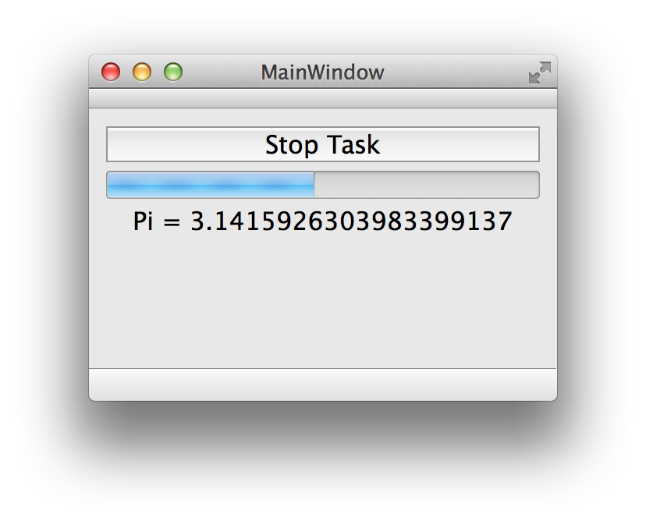
Lab – Pi Calculator
You are provided with a worker object, which calculates pi digits
Your task is to run the worker in its own thread
Pay attention to
Proper memory management
Proper thread termination and cleanup
Communication between the worker and UI widgets
Read the implementation details in readme.txt
lab-multithreading

Slide 198
QtConcurrent

Slide 199
Contents
Concurrent Tasks
Mapping and Filtering

Slide 200
Objectives
Learn…
…how to use QtConcurrent name space to run concurrent tasks
…how to synchronize tasks
…how to manipulate item containers concurrently

Slide 201
Qt Concurrent
High-level framework for parallel algorithms
Actually a namespace
Work is automatically distributed over an optimal number of threads, determined at runtime
Based on the thread pool like QRunnable interface
Supports executing concurrent tasks QtConcurrent::run()
Supports manipulating item containers concurrently

Slide 202
Concurrent Tasks
QFuture<T> QtConcurrent::run(Function function,…)
QFuture is a result of an asynchronous computation
Not QObject
Provides pause and resume functionality
Provides progress information
Allows functionality to iterate through the results
Other useful functions:
isFinished()
isRunning()
isStarted()
waitForFinished()
Uses a free thread from a thread pool

Slide 203
QFuture Example
int myFunction()
{
int result(0);
Q_FOREVER {
// Calculate result
if (thread()->isInterruptionRequested())
return result;
}
}
void somewhereElse()
{
QFuture<int> result = QtConcurrent::run(myFunction);
// do some other work in parallel to myFunction
result.waitForFinished();
}

Slide 204
Other QFuture Functions
Multiple QFuture can be combined in a QFutureSynchronizer
For non-blocking synchronization, there is QFutureWatcher
Uses signals and slots
Enables the event driven functionality with threads

Slide 205
Future Examples
QFuture<int> f1 = ...; // QtConcurrent::run(…)
QFuture<int> f2 = ...;
QFutureSynchronizer<int> sync;
sync.addFuture(f1);
sync.addFuture(f2);
sync.waitForFinished(); // blocks
QFuture<int> future = ...;
QFutureWatcher<int> watcher;
watcher.setFuture(future);
connect(&watcher, &QFutureWatcher::finished(), this, &Observer::slotFinished);

Slide 206
Concurrent Container Manipulation
Data in a container may be transformed or filtered
Manipulate data in-place - map(), filter())
Copy data into a new container - mapped(), filtered())
Optionally, use reduction - mappedReduced(), filteredReduced())
Blocking mapping and filtering functions exist as well - blockingMapped() returns the result or asynchronous mapped() returns a future
The algorithms are defined in namespace QtConcurrent

Slide 207
QtConcurrent — Mapping
QtConcurrent can transform (map) sequences based on a user-defined mapping function
Only random access sequences (QVector, QList) should be used with QtConcurrent, forward sequences (QLinkedList, QMap,. . . ) can be used, but incur a performance penalty
The mapping function either takes one element of the sequence as an argument and returns the modified element (mapped()), or modifies the argument directly (map())
The order in which elements are processed is undefined, though the sequence is never reordered

Slide 208
QtConcurrent — Filtering
QtConcurrent can filter (grep) sequences based on a user-defined filter function
The filter function takes one element of the sequence as an argument and returns true (keep element) or false (drop element)
Filter functions are “unary predicates”
Filter and mapping functions may also be member functions of the elements in the sequence
QStringList input = ...;
QStringList lower =
QtConcurrent::blockingMapped(input, &QString::toLower);
Filtering and mapping are very similar, so in the following, we talk about mapping, and point out where filtering differs

Slide 209
QtConcurrent — Reduce Operation
In addition to mapping/filtering, QtConcurrent can optionally reduce the sequence with a user-defined reduce function
The reduce function takes the partial result by reference, and the next element of the sequence as arguments and modifies the partial result to incorporate the new element
The return value is ignored
void join(QString &result, const QString &next) {
result += next;
}
QtConcurrent::ReduceOptions specify how exactly the reduction is applied
Currently, reduction is never parallelized
The mapping part is parallelized
ex-futures

Slide 210
Questions and Answers
What is Qt Concurrent?
What are the differences between QtConcurrent::run() and QRunnable::run()?
How container data can be manipulated?
Is it possible to use Qt Concurrent in single core CPUs?
What should be taken into account in terms of containers, when using Qt Concurrent?

Slide 211
Summary
Qt Concurrent provides a high-level API for multitasking
Compared to low-level API, there is no for sub-classing
Tasks may also return values, wrapped into QFuture objects
Item containers may be transformed and filtered concurrently
Useful for random access sequences as the processing order is undefined

Slide 212
Network Programming

Slide 213
Contents
TCP/UDP Sockets
WebSockets
SSL Sockets
QNetworkAccessManager
Requests and Replies
DNS and Proxies
Cookies

Slide 214
Objectives
Learn…
…how to use TCP sockets, SSL sockets, and web sockets
…how to make network requests and handle network replies

Slide 215
Qt Network
Easy to use with high-level classes
Instead of QHttp and QFtp, use QNetworkRequest, QNetworkAccessManager, QNetworkReply
QTcpServer
QTcpSocket
QUdpSocket
QHostInfo
QNetworkInterface
QNetworkProxy
Add network module to your project file
QT += network

Slide 216
Sockets
UDP sockets
Write is automatically flushed and a signal is emitted
Read event is handled by the event loop and readyRead() signal is emitted
Check the availability of data using bytesAvailable()
Read the data
TCP connections handled in the same way
Set up the server by calling listen()
Connect to newConnection() signal
In the slot, call nextPendingConnection(), which returns a QTcpSocket object to communicate with the client
Socket returned by nextPendingCnnection() cannot be used in another thread
Sub-class QTcpServer and re-implement incomingConnection() to get a socket descriptor
Use the descriptor in another thread

Slide 217
Socket Sequence Diagram
QTcpSocket
QTcpServer
QTcpSocket
0. listen()
4. signal connected()
1. connectToHost()
2. signal newConnection()
6. signal bytesWritten()
5. write()
3. nextPendingConnection()
7. signal readyRead()
Client
Server

Slide 218
TCP Client Implementation
Create an instance of QTcpSocket
Call QAbstractSocket::connectToHost()
Data can be read and written using QIODevice read() and write() functions
Data may be serialized to the socket using QDataStream
QDataStream out(tcpSocket);
out << serializedObject;
Note that Qt has several versions of QDataStream
Use setVersion() if necessary

Slide 219
TCP Client Implementation
The signal readyRead() is emitted whenever data is avalable to be read on the socket
QDataStream in(tcpSocket);
in >> size;
in >> string;
Data may be sent in fragments
Not possible to de-serialize a large image directly from the stream, for example
The result would be incomplete image objects
Both QDataStream and QIODevice support transactions
QDataStream in(m_socket);
in.startTransaction();
QByteArray possiblyLargeDataArray;
qint32 someValue;
in >> possiblyLargeDataArray >> someValue;
if (!in.commitTransaction()) return;
createImage(possiblyLargeDataArray); // Now all data has been completely written

Slide 220
TCP Server Implementation
Create an object of class QTcpServer
Call listen() on that object
You can either specify the port to listen to or let QTcpServer pick a free one
serverPort() will tell you the one it is using
When a connection is made, the newConnection() signal is emitted
Upon this, call nextPendingConnection() to get a QTcpSocket that is already connected to the client, and that you can then use for communication

Slide 221
WebSockets
TCP connection, where the communication takes place using Web Socket protocol (ws://host:port)
Like in QNetworkAccessManager, it is possible to set an SSL configuration and a proxy
API very similar to TCP
QWebSocketServer – QTcpServer
Listens for connections, establishes connection
QWebSocket – QTcpSocket
Requests for a connection
Transfers data

Slide 222
WebSocket Sequence Diagram
QWebSocket
QWebSocketServer
QWebSocket
0. listen()
4. signal connected()
1. open()
2. signal newConnection()
5. sendTextMessage()
3. nextPendingConnection()
6. Signal textMessageRead()
Client
Server

Slide 223
QSslSocket
The class QSslSocket supports secure network access using either the SSLv3 protocol or the TLSv1 (default) protocol
QSslSocket inherits from QTcpSocket, and, after setup, the communication is just like with a QTcpSocket
Only supported backend for SSL is OpenSSL, which needs to be installed separately
Can be installed after the configuration

Slide 224
Ssl Socket Clients
The common way for clients is to call QSslSocket::connectToHostEncrypted(), which is similar to QTcpSocket::connectToHost(), except that it will set up a secure connection
After the connection request, clients should either call waitForEncrypted() or connect to the encrypted() signal
The signal is emitted after the secure connection has been established
Data may be written to the socket immediately after connectToHostEncrypted call (data will be queued)
QSslSocket *socket = new QSslSocket(this);
connect(socket, SIGNAL(encrypted()), this, SLOT(ready()));
socket->connectToHostEncrypted("address.com", 993);

Slide 225
Ssl Socket Servers
The easiest way to implement a SSL server is to inherit from QTcpServer, and override incomingConnection(int socketDescriptor)
A QSslSocket is then constructed based on the socket descriptor
Once this is set up, handshaking is started using startServerEncryption()
void SslServer::incomingConnection(int socketDescriptor)
{
serverSocket = new QSslSocket;
if (serverSocket->setSocketDescriptor(socketDescriptor)) {
connect(serverSocket, SIGNAL(encrypted()), this,
SLOT(ready()));
serverSocket->startServerEncryption();
}
}

Slide 226
Network Access Manager
Instead of direct HTTP protocol interface (QHttp) it is recommended to use QNetworkAccessManager interface
Create a QNetworkAccessManager object
Call a desired function (get(), post(), head(), post()) with one QNetworkRequest holding the URL
Receive a QNetworkReply object as the response
In addition setProxy() and setCookieJar() configure proxies and cookie handling
QNetWorkAccessManager* accessManager = new QNetworkAccessManager(this);
accessManager->get(new QNetworkRequest(new
QUrl("http://lively.cs.tut.fi/images/add.ico")));
connect(accessManager, SIGNAL(finished(QNetworkReply*)), this,
SLOT(doStuffWithResult(QNetworkReply*)));

Slide 227
Network Request
The argument to the methods of QNetworkAccessManager are instances of QNetworkRequest
Requests are queued by the network access manager
Requests are handled in parallel (6 on the desktop platforms)
In the simplest setup, QNetworkRequest is created with a QUrl as argument
SSL is configured using setSSLConfiguration()
No default configuration – selected by the backend
Raw headers may be configured using:
setHeader(KnownHeaders headerName, QVariant headerValue)
setRawHeader(QByteArray headerName, QByteArray headerValue)

Slide 228
Network Reply
The methods of QNetworkAccessManager are all asynchronous
The result of the calls are instances of a QNetworkReply
The signals QNetworkReply::finished() and QNetworkAccessManager::finished(QNetworkReply*) tells you when the operation is done
The signal downloadProgress(qint64, qint64) respectively uploadProgress() informs you about progress

Slide 229
Network Reply
Errors are signaled with error(NetworkError) - a printable string may be obtained from errorString()
QNetworkReply is a subclass of QIODevice
Uses sequential (rather than random) access
Note: : It is your responsibility to delete the QNetworkReply object
Do not delete in the slot (use deleteLater())
ex-multi-download

Slide 230
Additional Features
Network configurations (QNetworkConfiguration)
May be set explicitly by the developer
Use WiFi, CDMA, 4G, Ethernet, …
Cache (QAbstractNetworkCache, QNetworkDiskCache)
Allows storing data into any QIODevice using streaming operators
Maximum size and cache load control may be set
Cookies (QNetworkCookieJar, QNetworkCookie)
Name, value, secure, domain (./foo/bar)
Proxy (QNetworkProxy)
Type, host name, port, user, password

Slide 231
Authentication
Whenever authentication is required, a signal QNetworkAccessManager::authenticationRequired(QNetworkReply, QAuthenticator) emitted
Direct connection must be used (authentication credentials must be provided when the signal returns)
Credentials cached by the network access manager
Read the header information from the reply
Set user name and password in the authenticator

Slide 232
Proxies
Proxies can be set up with the class QNetworkProxy
QNetworkProxy is used to identify HTTP, FTP and SOCKS5 proxies
HTTP and FTP proxies can perform caching
To use a proxy:
Create a QNetworkProxy object and populate it with hostname, port, etc.
Assign the proxy globally with the static method QNetworkProxy::setApplicationProxy() or just on one socket using setProxy()

Slide 233
Customizing Proxies
Proxy factories are used to create policies for proxy use
QNetworkProxyFactory supplies proxies based on queries for specific proxy types
Queries are encoded in QNetworkProxyQuery objects
proxyForQuery() is used to query the factory directly
To change the behavior, reimplement queryProxy()
To implement an application-wide policy with the factory, call setApplicationProxyFactory()
This overrides any proxy set with QNetworkProxy::setApplicationProxy()
Querying QNetworkProxy::applicationProxy() causes the factory to be queried

Slide 234
Proxy Queries
Queries enable proxies to be selected based on key criteria:
The purpose of the proxy: TCP, UDP, TCP server, URL request
Local port, remote host and port
The protocol in use: such as HTTP or FTP
The URL being requested

Slide 235
Questions and Answers
How web sockets API differs from TCP socket API?
What options exist for reading/writing data using sockets?
What should be taken when using sockets in a multi-threaded program?
How can you make REST API requests?
Would it make sense to handle network access manager requests in separate threads to keep the GUI thread responsive?
Is there anything in common between a TCP socket and network reply?
How cookies are managed in Qt?

Slide 236
Summary
Qt network module provides several classes for networking
UDP socket classes
TCP sockets
SSL sockets
Host name resolving services
For HTTP and FTP networking, use QNetworkAccessManager
QHttp and QFtp still work in Qt5 as an add-on module, so your old programs do not need re-implementation
Network access manager provides classes for making any kind of a network request and handling any kind of a network reply

Slide 237
WebEngine

Slide 238
Contents
Qt WebEngine Widgets
Handling Asynchronous Functions
Exposing Qt objects to JavaScript Engine

Slide 239
Objectives
Learn…
…the overall class hierarchy of Qt WebEngine classes
…asynchronous nature of some WebEngine APIs
…how to use Qt objects APIs in WebEngine

Slide 240
Qt WebEngine
Provides a browser engine and web content interactions both in C++ and QML
Based on Google’s Chromium project
Qt also has Qt WebView module, which provides browser functionality in QML without a full web browser stack
Used in mobile platforms
Chromium project
has cross-platform focus
provides browser on all major desktop platforms and Android
Many features in Chromium work out-of-the-box without requiring Qt code
Platform/OS adaptation
Multimedia
HTML5 features such as WebRTC

Slide 241
Qt WebEngine
Essential features in addition to web rendering
JS execution
Page conversion to HTML or to the plain text
Storage and cache management
Navigation history
Exposing Qt objects to JavaScript engine
GUI process separated from the WebEngine process, taking care of page rendering and JS execution
Functions, resulting in inter-process communication, are asynchronous by nature
Note that WebEngine Widgets use Qt Quick scene graph for composing page elements
Widgets rendering requires the scene graph rendering backend

Slide 242
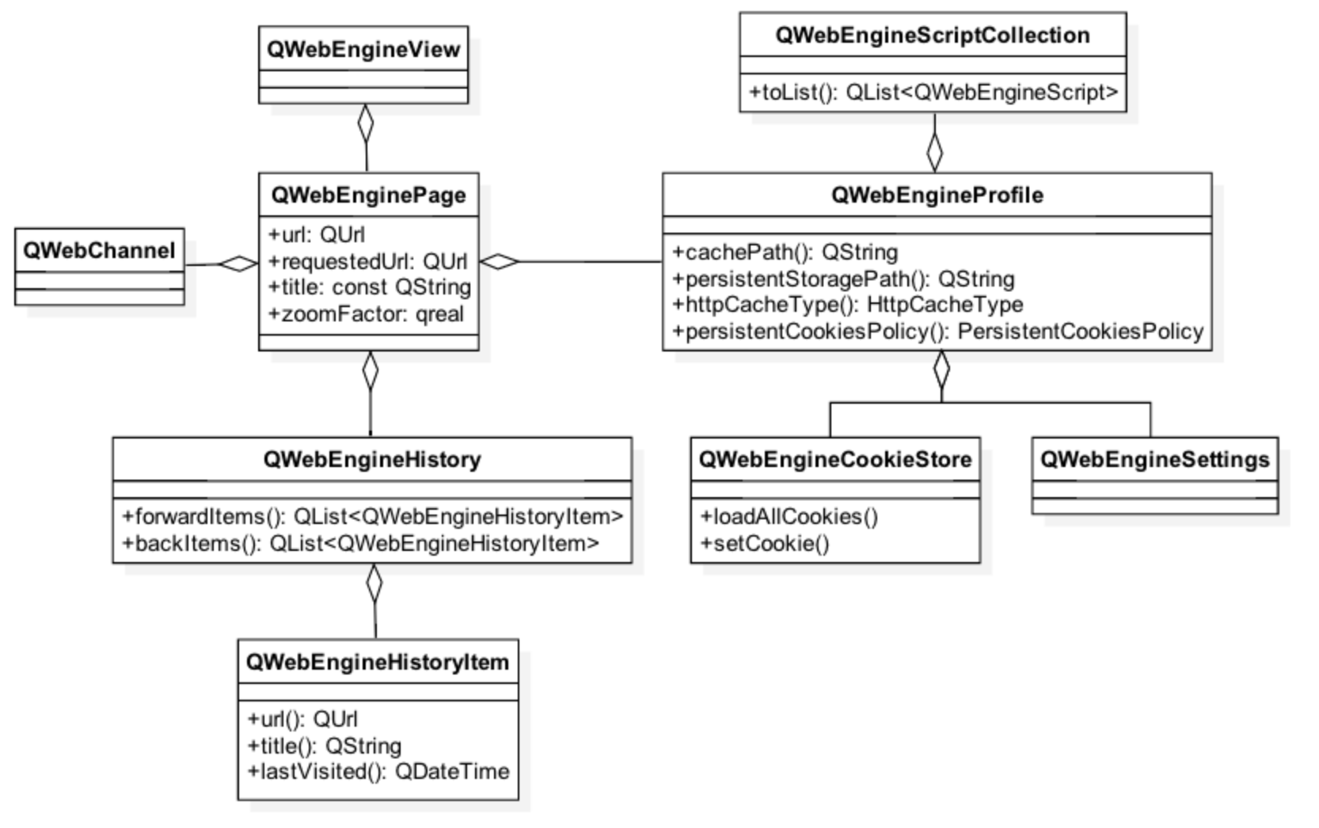
Qt WebEngine Widgets

Slide 243
QWebEngineView and QWebEnginePage
QWebEngineView
Allows editing and viewing web content
Functions: load(), setUrl(), setHtml(), setContent(), setPage()
Window management: createWindow() – called, when a new window requested in JavaScript
QWebEnginePage
Run JavaScript: runJavaScript()
Manage permissions: setFeaturePermission()
Trigger action: cut, paste, reload and bypass cache, redo, undo
Authentication: authenticationRequired()
Each page belongs to a profile with shared settings
Profile may be page-dedicated to allow private browsing
QWebEngineView *view = new QWebEngineView(parentObject);
view->load(QUrl("http://www.qt.io/"));
view->show();

Slide 244
Other Essential Classes
QWebEngineSettings
Font settings
Web attributes: auto load images, JS enabled, local storage enabled, JS can open windows
QWebEngineHistory
Stores the navigation history in history items
Items may be accessed using currentItem(), backItems(), forwardItems()
QWebEngineProfile
Profile shared by multiple pages
Access to settings
Storage path, cache path management
Cache types: memory or disk
QWebChannel
Used to expose QObjects to HTML clients

Slide 245
Handling Asynchronous Functions
Because of multi-process architecture, some of the web engine functions are asynchronous
Asynchronous functions take a functor or lambda argument
For example, QWebEnginePage allows to convert the web page to HTML or plaint text
void MainWindow::on_pushButton_clicked()
{
QTextBrowser *textBrowser(ui->textBrowser);
m_view->page()->toPlainText([textBrowser](const QString &result) {
textBrowser->setText(result);
});
}

Slide 246
Exposing Qt Object to JavaScript Engine
QWebChannel allows exposing QObject properties, public slots and methods to HTML
Also property updates and signal emissions on the C++ side automatically transmitted to HTML clients
Web channel requires a transport object for the communication between a C++ app and (possibly remote) HTML client
The transport object must implement an interface QWebChannelAbstractTransport::sendMessage(const QJsonObject &msg)
The implementation serializes the message and sends it to the client

Slide 247
Web Socket as Web Channel
QWebSocket can be used as a transport channel
Implement sendMessage() using QWebSocket::sendTextMessage();
Emit the transport object messageReceived() signal in the slot, connected to QWebSocket::textMessageReceived() signal
Web channel must be connected to the transport object
Connect a signal with the transport object argument to QWebChannel::connectTo() slot

Slide 248
Exposing Qt Object to JavaScript Engine
// Derives QWebChannelAbstractTransport
void WebSocketTransport::sendMessage(const QJsonObject &message)
{
QJsonDocument doc(message);
m_socket->sendTextMessage(QString::fromUtf8(doc.toJson(QJsonDocument::Compact)));
}
// A slot, connected to QWebSocket::textMessageReceived(const QString &msg) signal
void WebSocketTransport::textMessageReceived(const QString &messageData)
{
QJsonParseError error;
QJsonDocument message = QJsonDocument::fromJson(messageData.toUtf8(), &error);
if (error.error) {
qWarning() << ”Parse error:" << messageData << error.errorString();
return;
}
else if (!message.isObject()) {
qWarning() << "Received JSON message that is not an object: " << messageData;
return;
}
emit messageReceived(message.object(), this);
}

Slide 249
Exposing Qt Object to JavaScript Engine
QWebChannel provides an API to register one or more QObjects
channel.registerObject(QStringLiteral(”myObject”), &object);
In the client side,
Create a web socket and provide callback functions onError(), onClose(), onOpen()
In onOpen(), create a web channel with a web socket and callback arguments
new QWebChannel(socket, function(channel) { } )
Registered objects are available through channel.objects
Essential functionality is provided by qwebchannel.js
The transport object is accessible through navigator.qtWebChannelTransport

Slide 250
Exposing Qt Object to JavaScript Engine
<script type="text/javascript" src="./qwebchannel.js"></script>
window.onload = function() {
var socket = new WebSocket(“ws://127.0.0.1:4321”);
socket.onclose = function() {
console.error(”Channel closed");
};
socket.onopen = function() {
new QWebChannel(socket, function(channel) {
// Access a property
var propertyValue = channel.objects.myObject.propertyX;
// Access a method
channel.objects.myObject.somePublicMethod(propertyValue);
// Access a signal
channel.objects.myObject.someSignal.connect( function() { } );
};
};
ex-exposing-objects

Slide 251
Questions and Answers
How QWebEngineView is different from other widgets in terms of rendering?
How do you access sub-frames?
What is QWenEngineProfile?
How cookies can be managed in Qt WebEngine?
How can you use browser functionality in Qt applications in mobile platforms?
How to expose Qt object to JS engine?

Slide 252
Summary
Qt WebEngine allows having web browser functionality in applications
Both C++ widgets and QML types can be used
In addition to page browsing, pages can be edited and converted to HTML or plain text
Pages allow execution of JavaScript methods
Qt objects may be exposed to JavaScript engine
Qt object features exposed in meta-object becomes accessible in the script engine

Slide 253
Thank You!
www.qt.io

